Slide 1

NEOs and PHAs – Detection, Tracking, Characterisation
Richard Moissl for the Planetary Defence Office Team
Observers: Marco Micheli, Dora Föhring, Luca Conversi, Francisco Ocaña, Rainer Kresken
26/09/2024

Slide 2
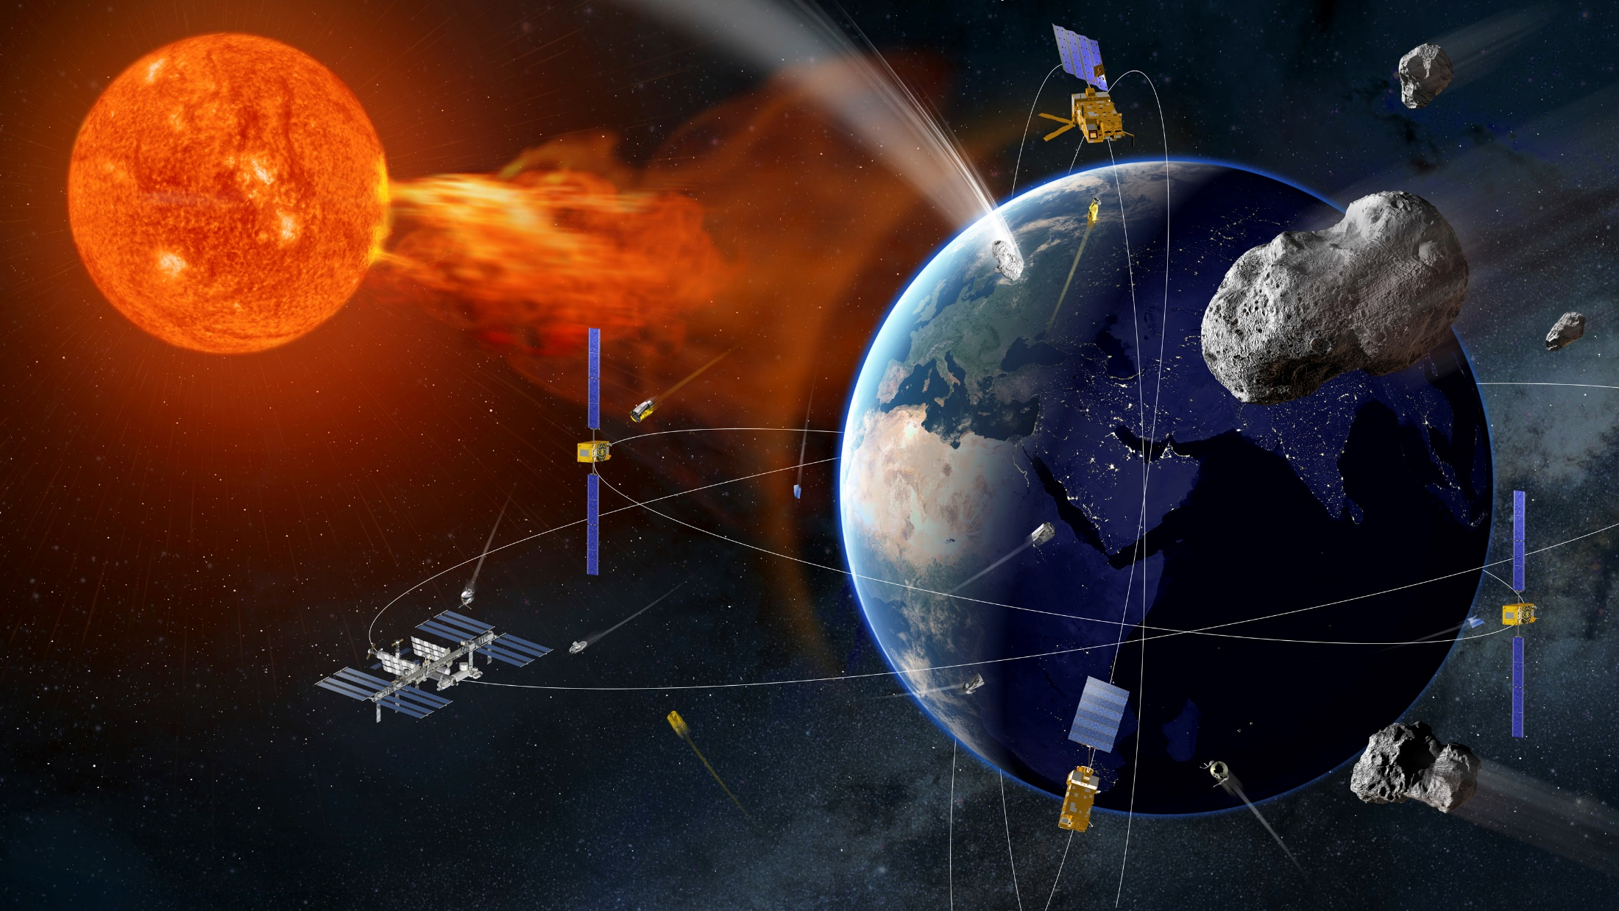
ESA Space Safety Programme (S2P)
Planetary Defence
Space Weather
Space Debris und Clean Space

Slide 3
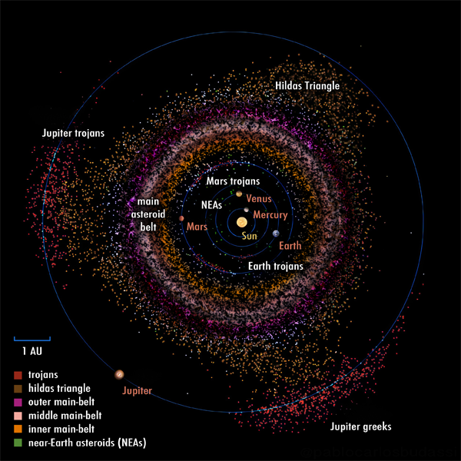
(Near Earth) Asteroids
Descriptive name for “Star-like” celestial bodies [“Minor Bodies”]
Large numbers[>> 1000000] and present throughout the solar system
Vast differences in all parameters
On Heliocentric Keplerian orbits
Of particular interest once their orbits get close [<0.3 au] to the Earth’s orbit => NEA
Together with Comets => NEO
Graphic by: Pablo Carlos Budassi

Slide 4
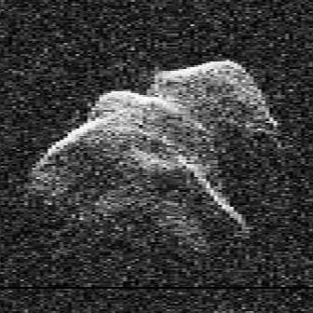
Potentially Hazardous Asteroids/Objects
Objects with a potential to cause large scale destruction on Earth
Defined with a maximum absolute Magnitude H of 22
Sizes of ~140 m diameter and more
Trajectories approaching Earth Orbit to 0.05 au or less
Threatening to Infrastructure on more local scales already from ~30 m diameter!

Slide 5
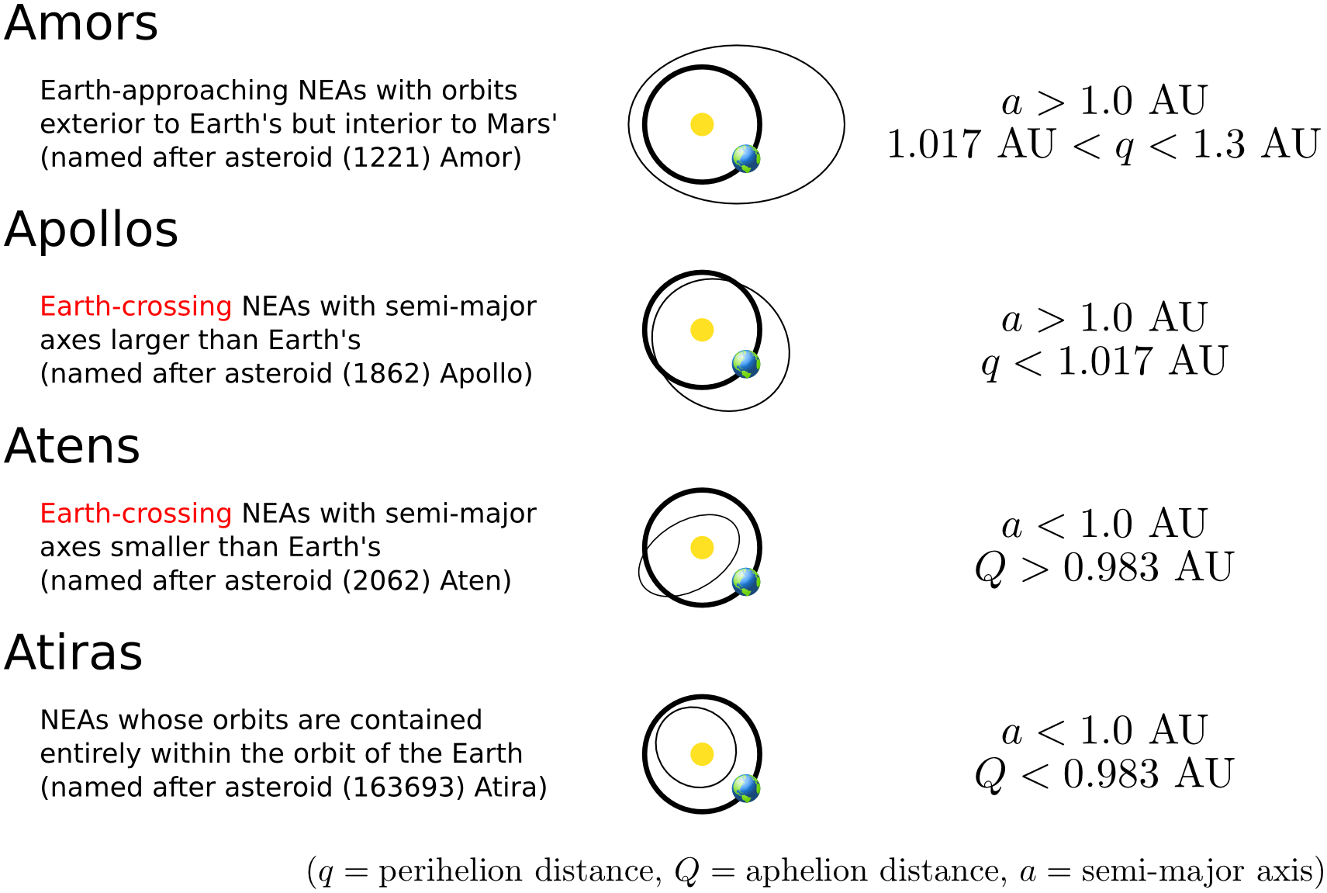
GROUPS OF NEOs
Credit: NASA / CNEOS

Slide 6

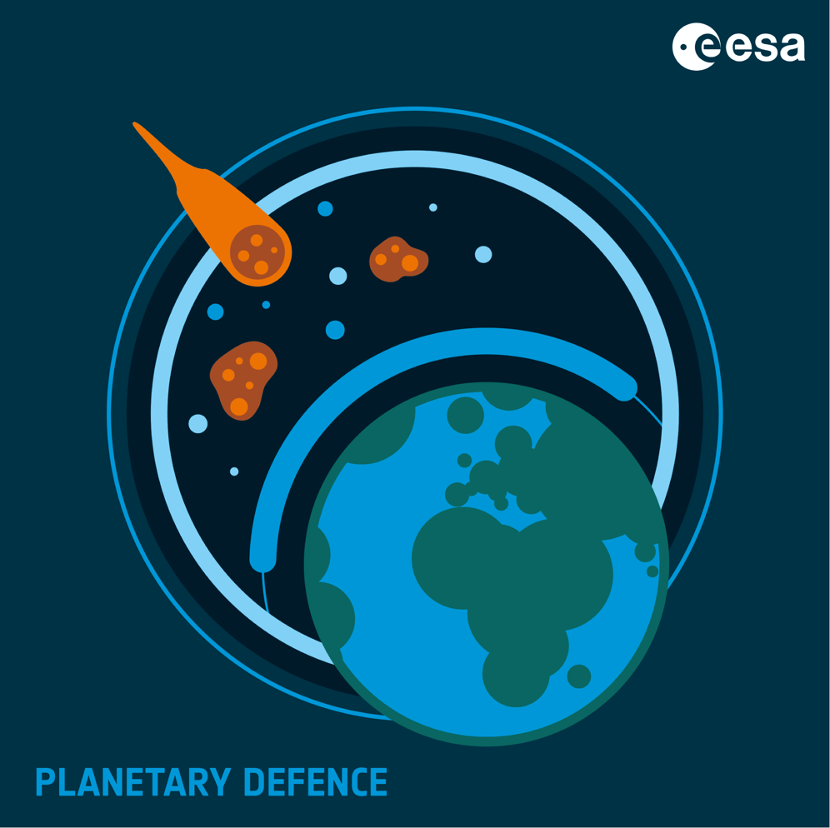
Das ESA Planetary Defence Office
“The goal of Space Safety is [] the protection of our planet, humanity and assets in space and on Earth from dangers originating in Space”
Detection of Near-Earth Objects, determining their dynamic and physical properties
Assessment and prediction of impact risk, warning decision makers and disaster relief forces in case of threats
Risk mitigation through potential reconnaissance and/or deflection missions
This is our logo

Slide 7
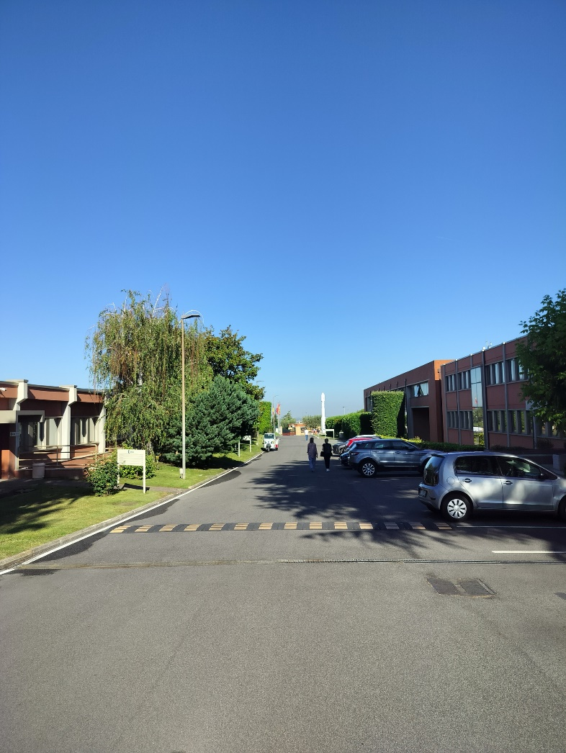
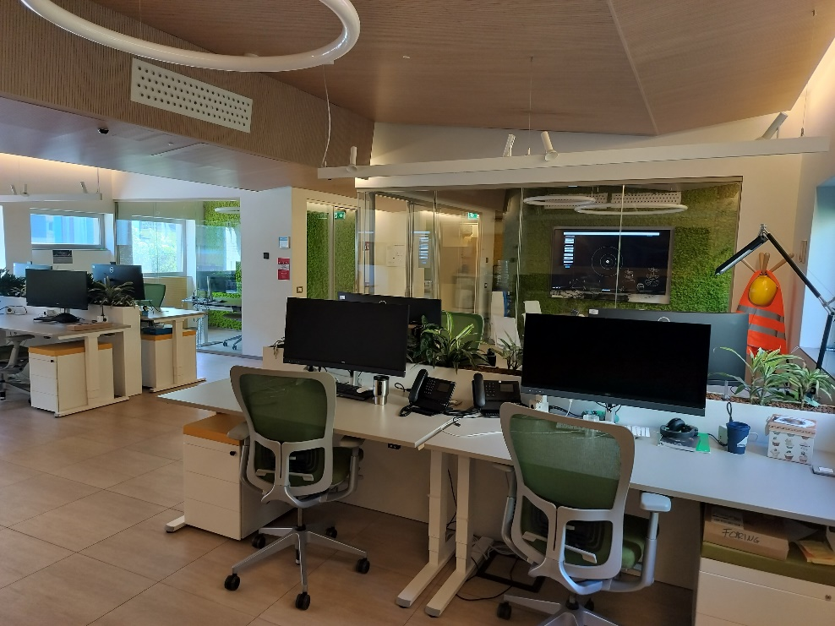
Headquarter: The NEO Coordination Centre (NEOCC)
Located at ESRIN in Frascati (some colleagues also in other ESA establishments)
SSA-NEO Coordination Centre: ‘Building 18’ at ESRIN, hosts ~10 people
Images: ESA/NEOCC

Slide 8
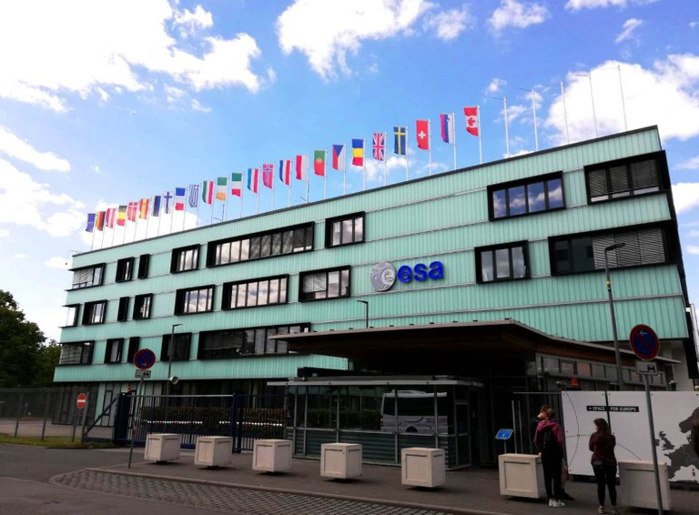
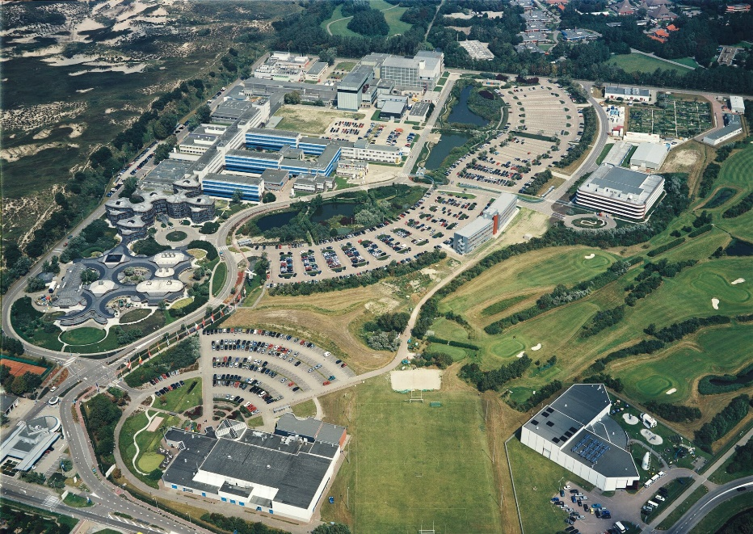
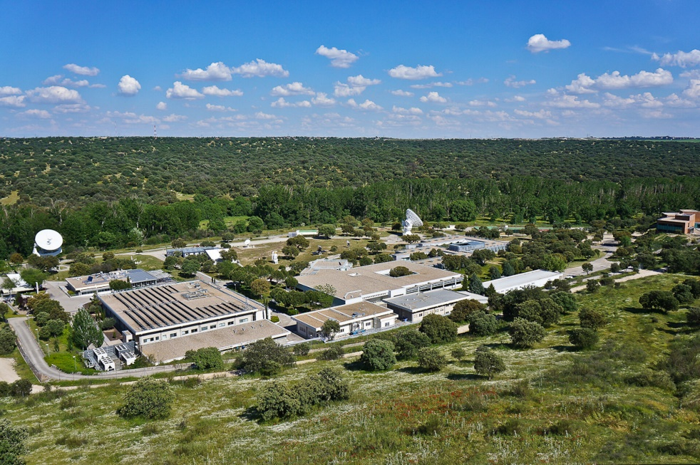
…and distributed across Europe
16 People plus support from other ESA units
ESOC (Germany)
ESTEC (Netherlands)
ESAC (Spain)

Slide 9
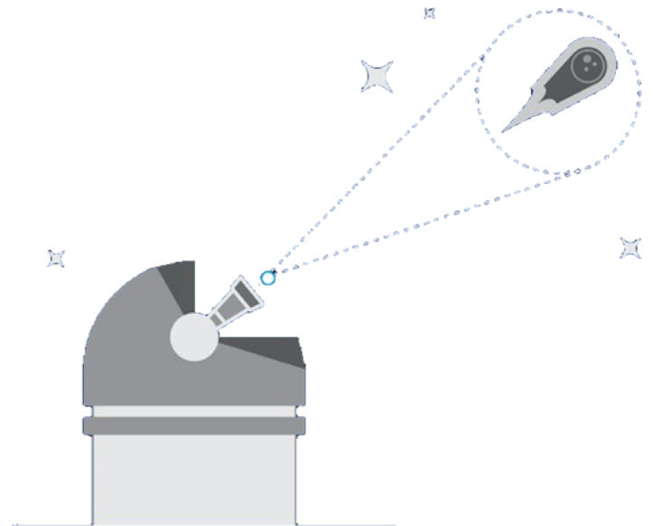

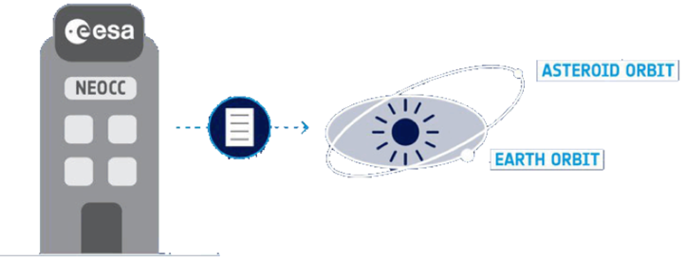
Planetary Defence workflow in a nutshell
Mitigation
Observations
Information Provision
Asesssment

Slide 10
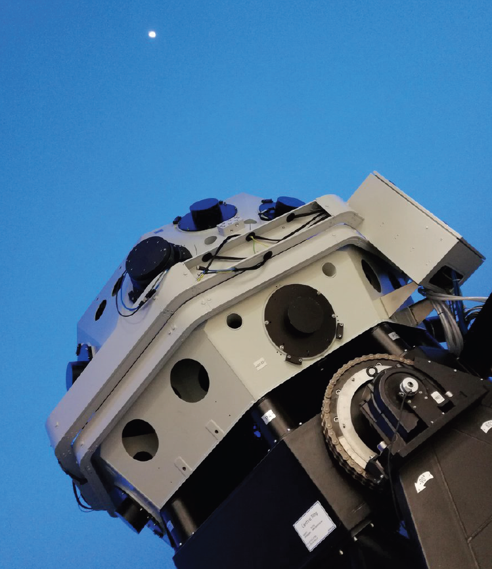
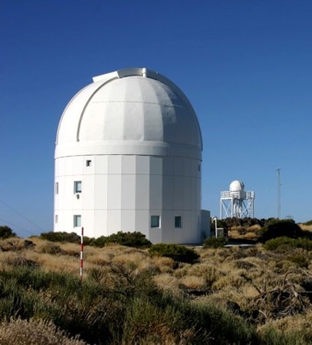
Observations
Survey
Follow-up

Slide 11
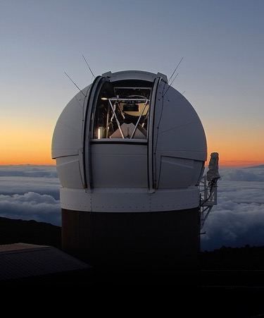
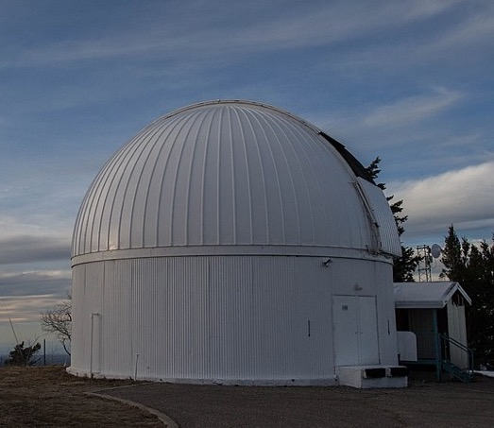
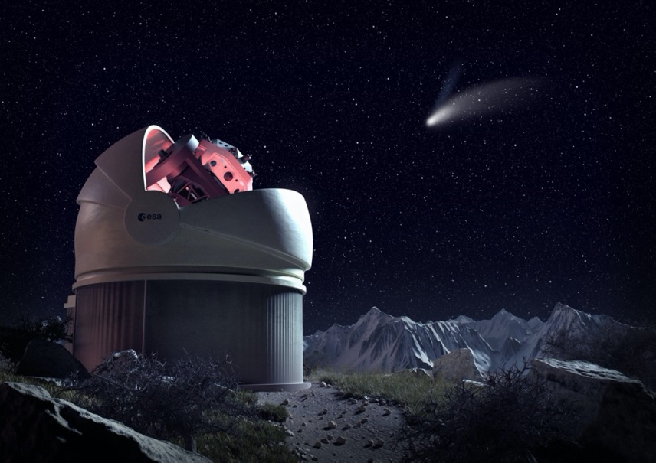
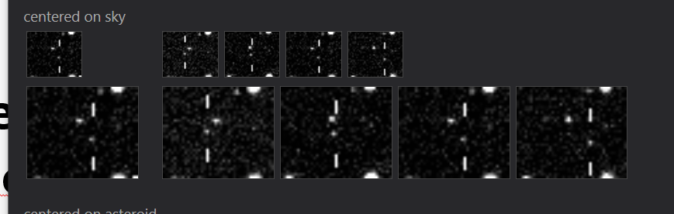

Surveys
Pan-STARRS, Hawaii, USA
Catalina Sky Survey, Arizona, USA
ESA FlyEye Telescope (under construction)
ATLAS Survey, Hawaii, USA
CSS / D. Oberhaus
Pan-STARRS

Slide 12

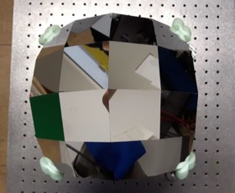
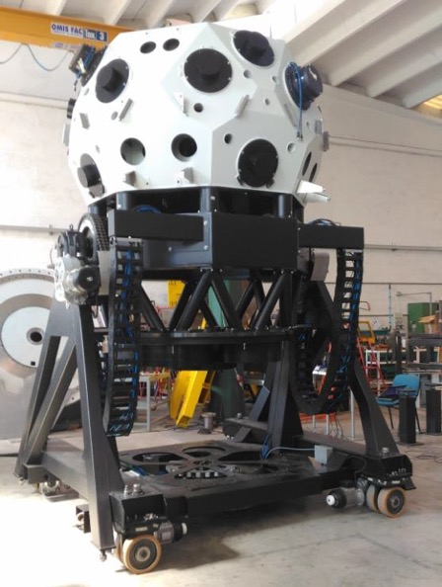
The Flyeye Telescope (Network)
Very wide Field of View: 6.7° x 6.7°
Scanning entire sky every 2 nights
Image split into 16 “Facets”
Construction lead by OHB Italy
Consortium with 9 other industries from LU, ES, RO, PO, CZ, DE, NO
3 Stations for global coverage

Slide 13
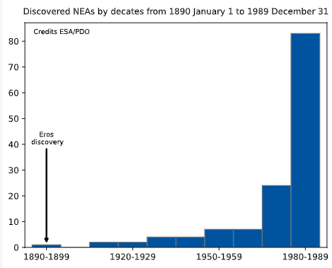
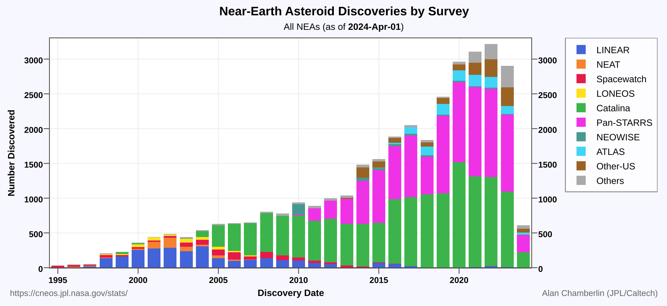
Discovery Statistics

Slide 14
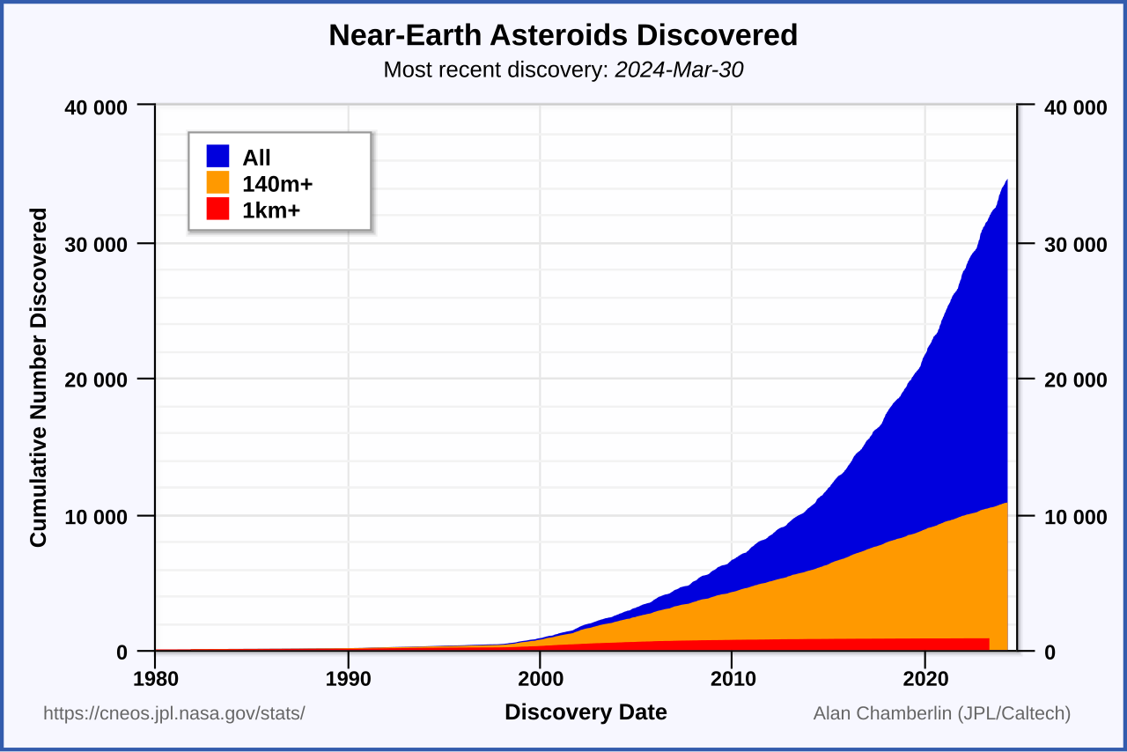
How many NEAs are there?
Credit: NASA / CNEOS

Slide 15
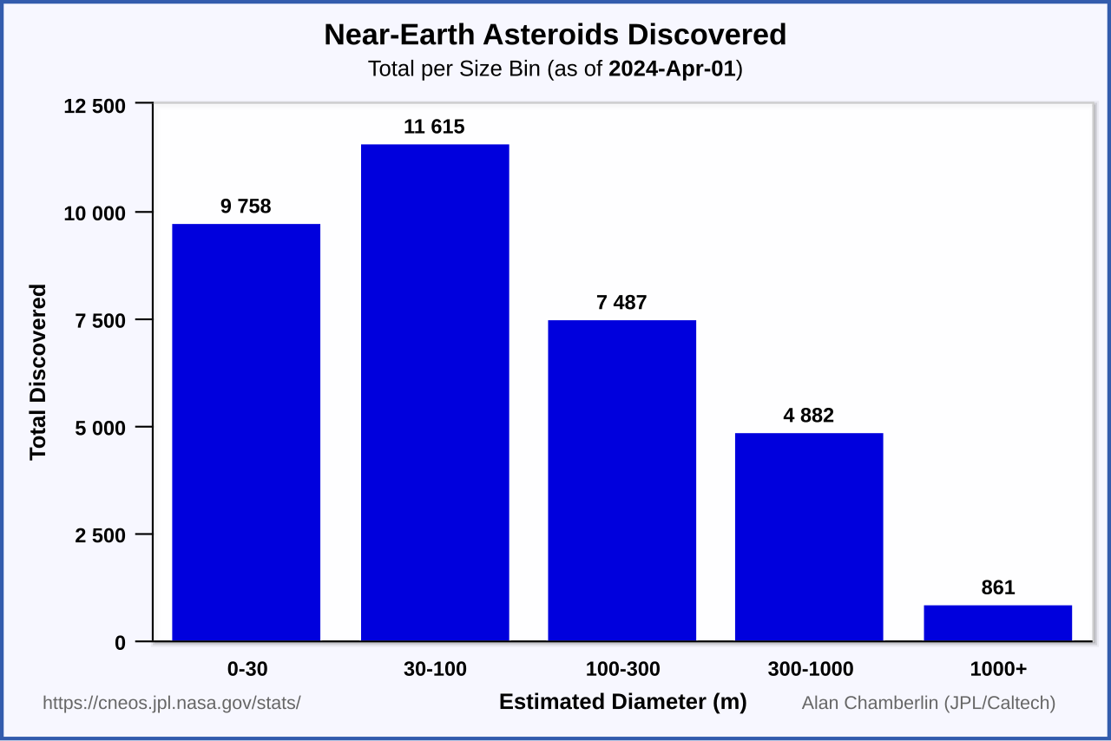
What is the size distribution?
Credit: NASA / CNEOS

Slide 16
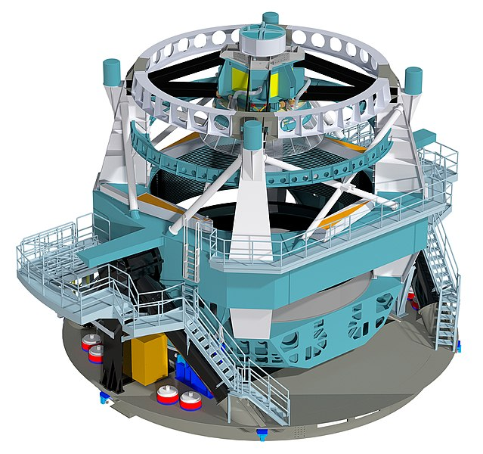
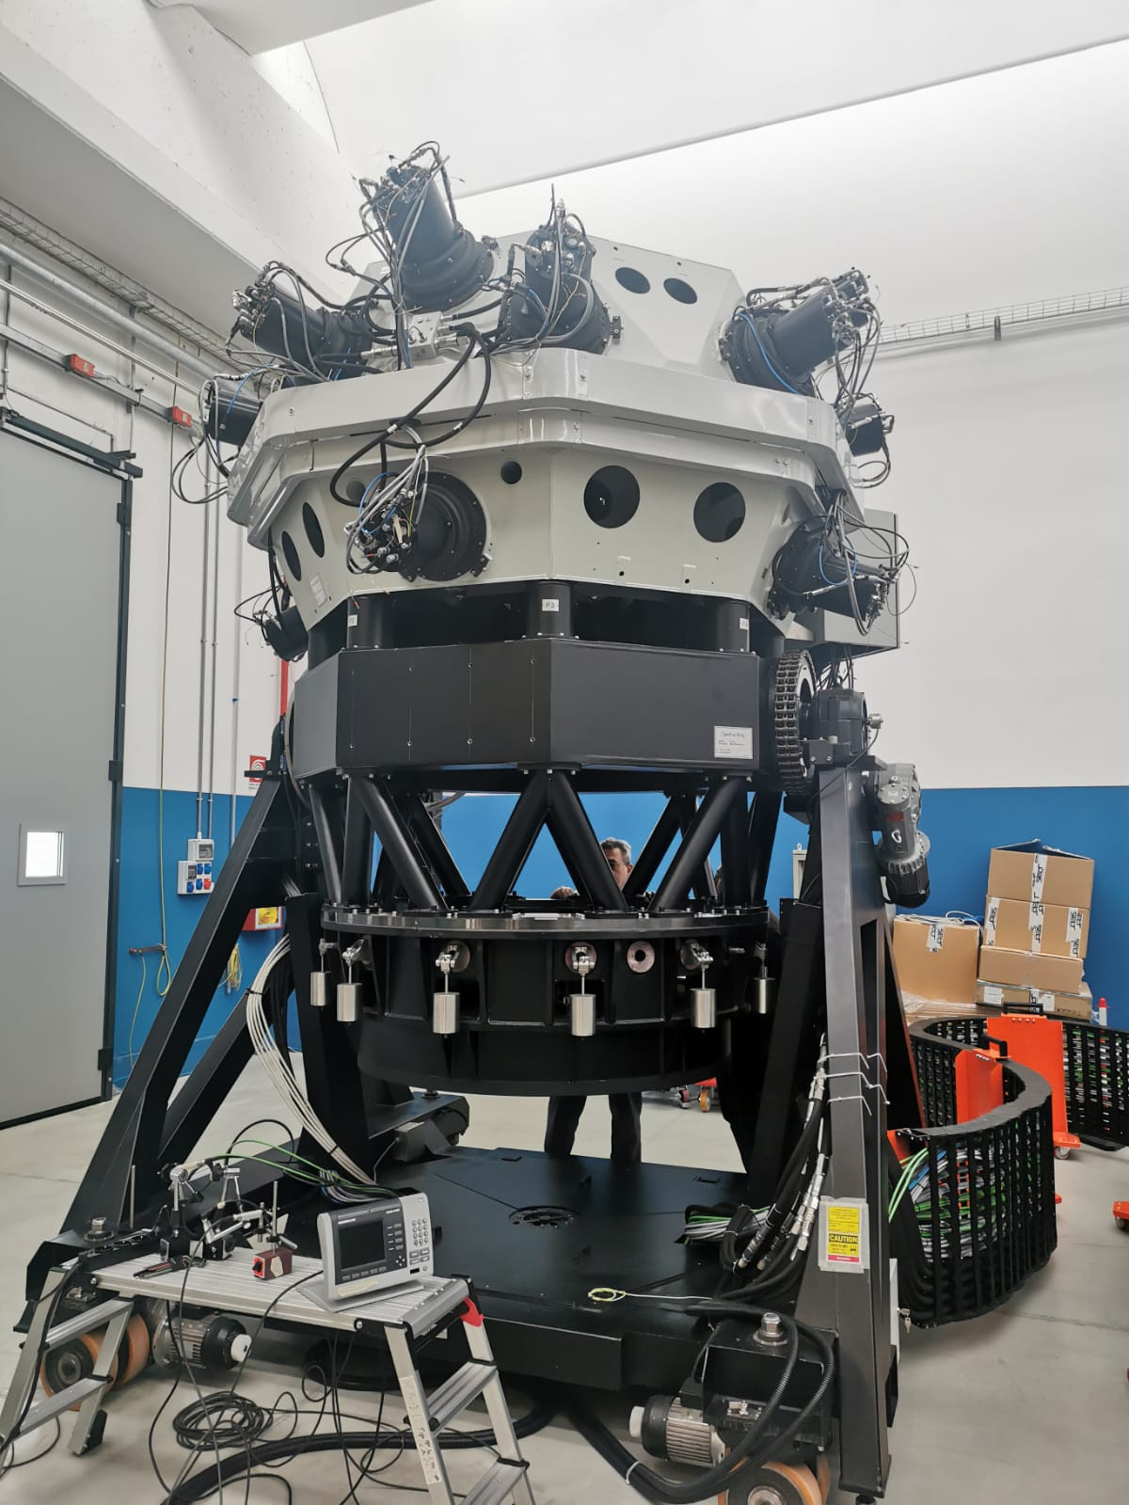
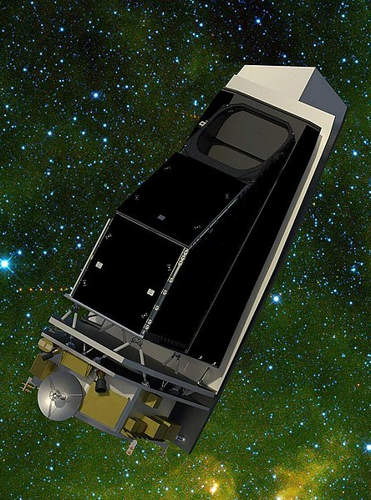
Surveys: the future
Future facilities plan to address most of these limitations:
Additional projects are under study or initial development to cover an even larger observational parameter space (e.g. ESA’s NEOMIR mission to survey at very low elongations).
LSST
ESA / OHB
NASA / JPL-Caltech / University of Arizona
ESA / NEOMIR

Slide 17
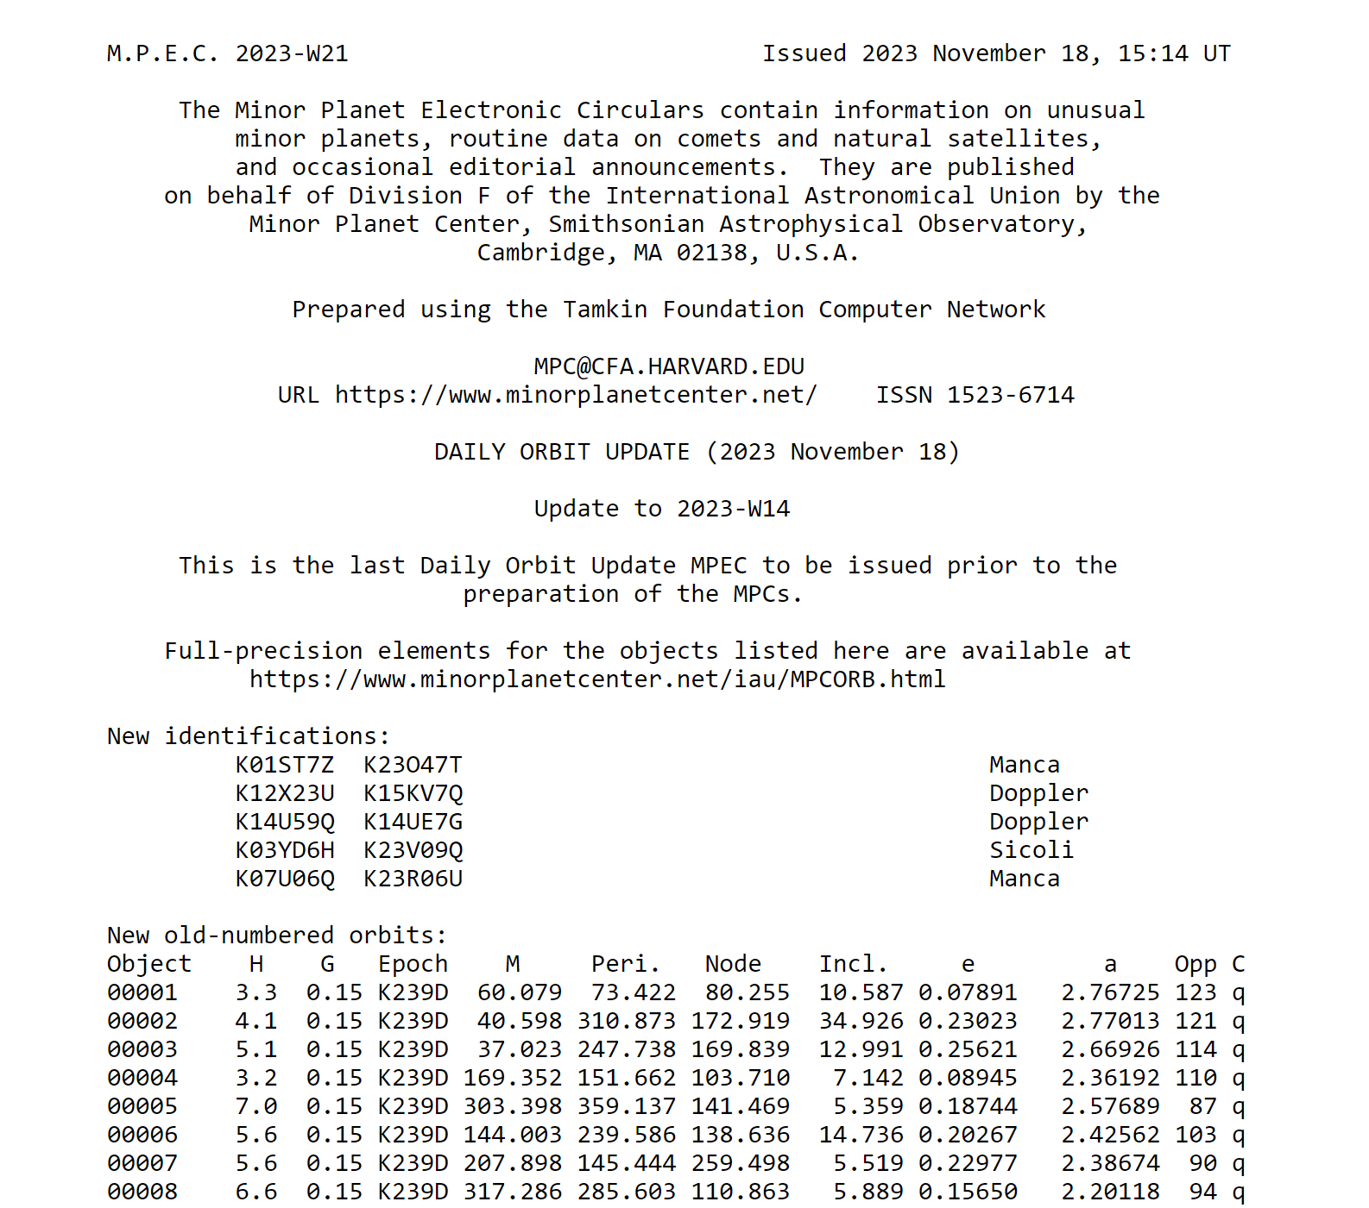
The Minor Planet Center (MPC)
The MPC is responsible for the designation of minor bodies in the solar system: minor planets; comets; and natural satellites.
The MPC is also responsible for the efficient collection, computation, checking and dissemination of astrometric observations and orbits for minor planets and comets.
Observers around the world provide the observations that are collected and disseminated by the MPC.
The MPC operates at the Smithsonian Astrophysical Observatory (SAO), under the auspices of the International Astronomical Union (IAU). MPC is funded by NASA.

Slide 18
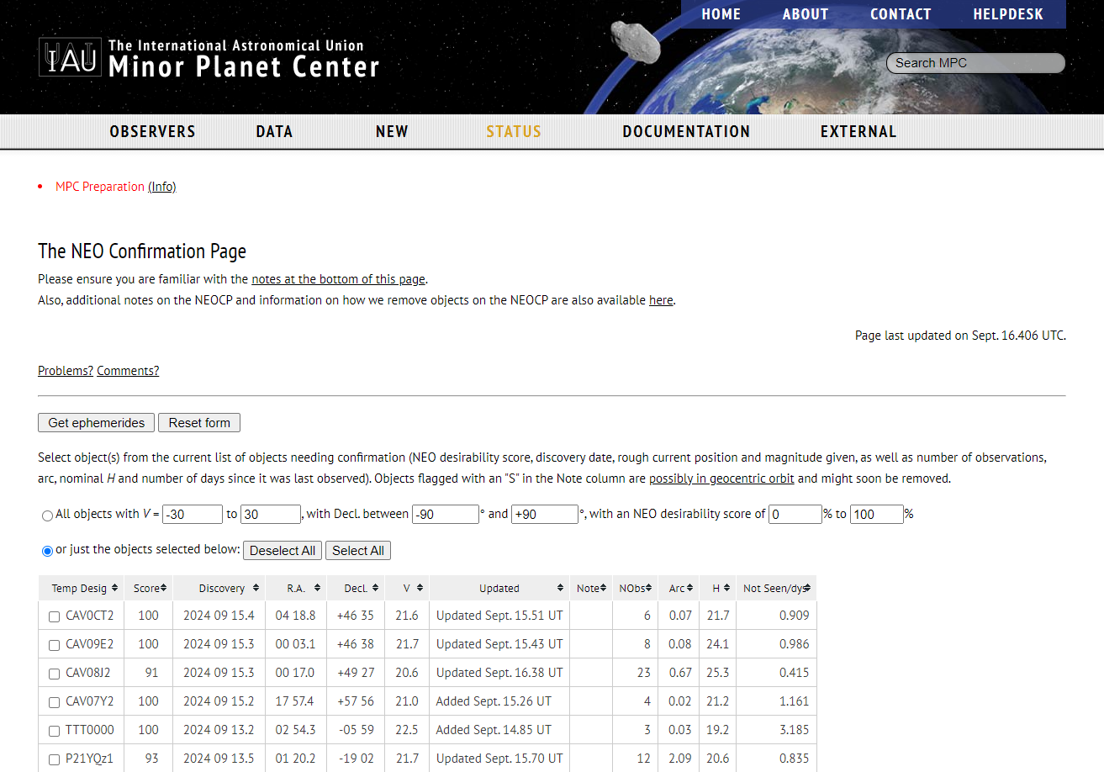
The Near Earth Object Confirmation Page

Slide 19
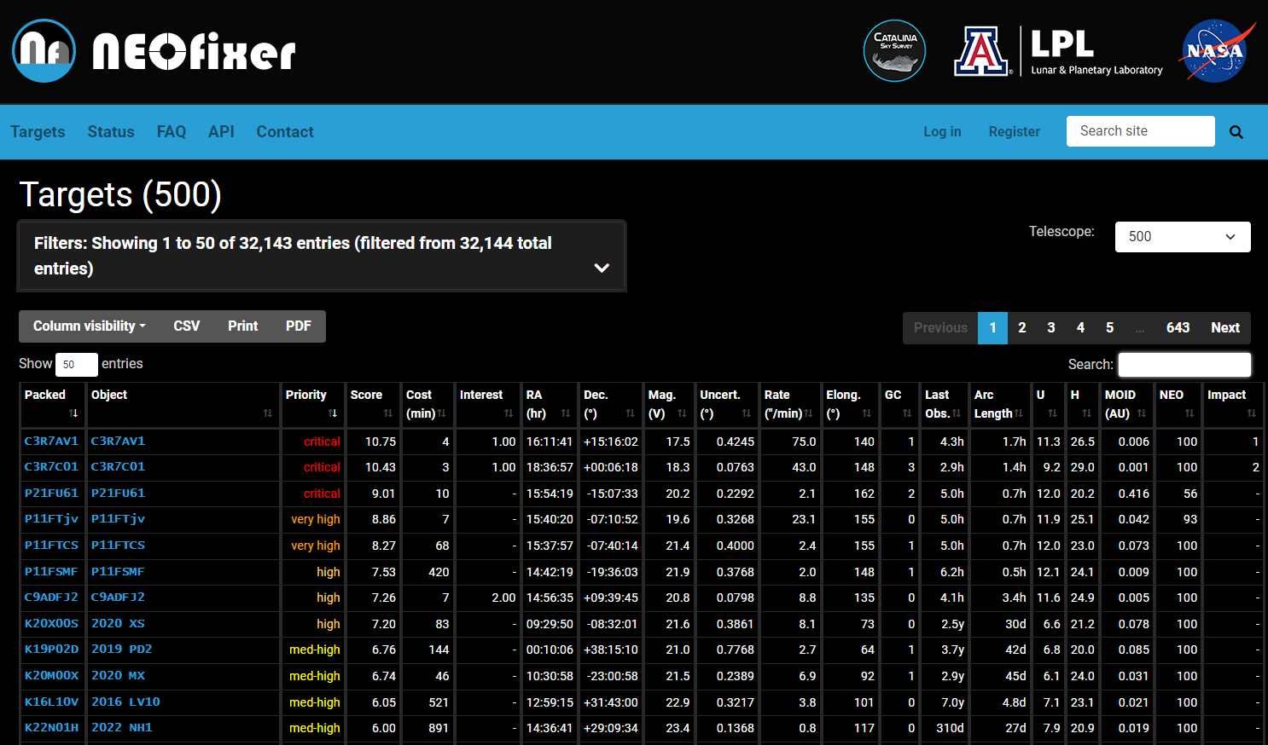
How to ensure the “right” follow-up?
Unfortunately, a large fraction of new discoveries are still going lost after a few days.
A system to coordinate follow-up is needed.
Efforts in this direction are being developed by various teams (e.g. Catalina Sky Survey in the US, NEOROCKS project in Europe).
Main goals:
Ensure follow-up of high-priority targets.
Minimize duplication of effort.
Facilitate exchange of information.
Better evaluate the importance of each contribution.
Arizona Board of Regents / University of Arizona.

Slide 20
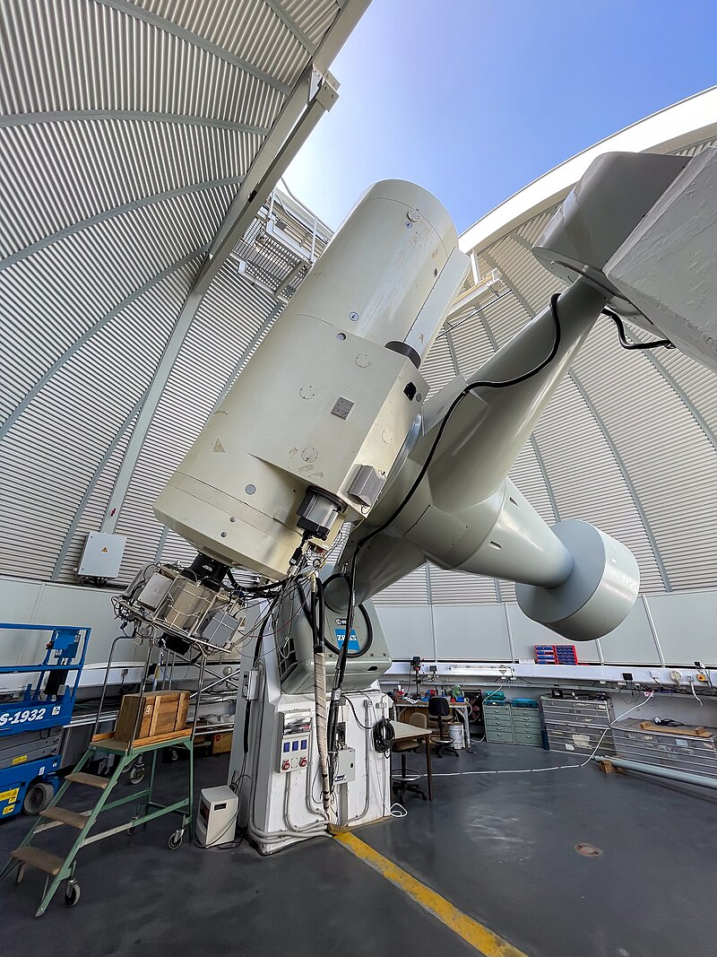
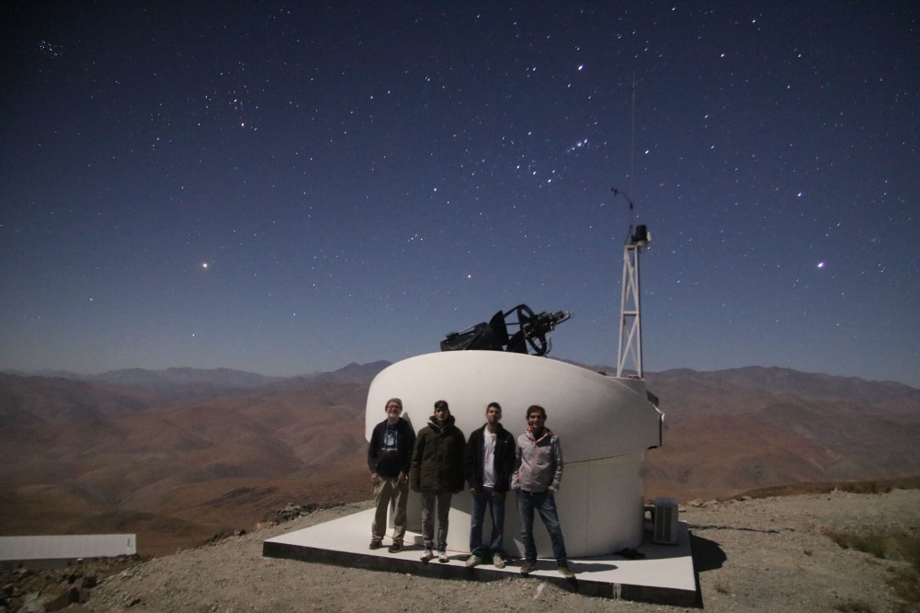
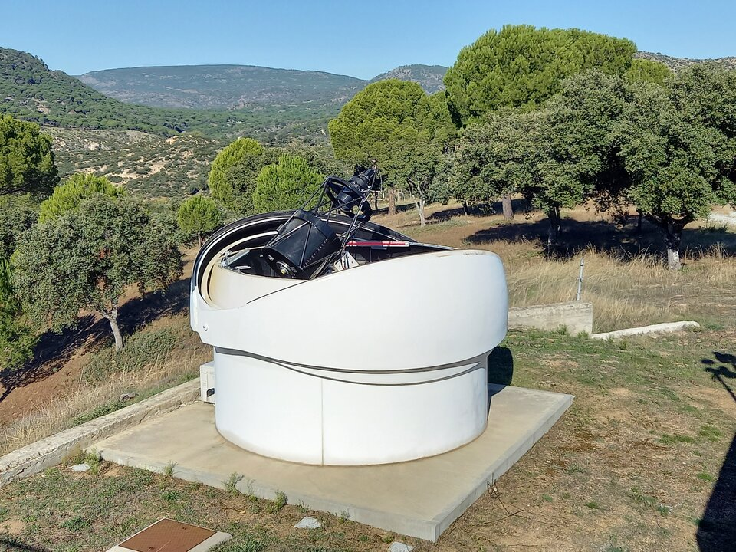
Follow-up
0.56-m TBT LaSilla, Chile
0.56-m TBT Cebreros, Spain
1-m Optical Ground Station, Spain

Slide 21
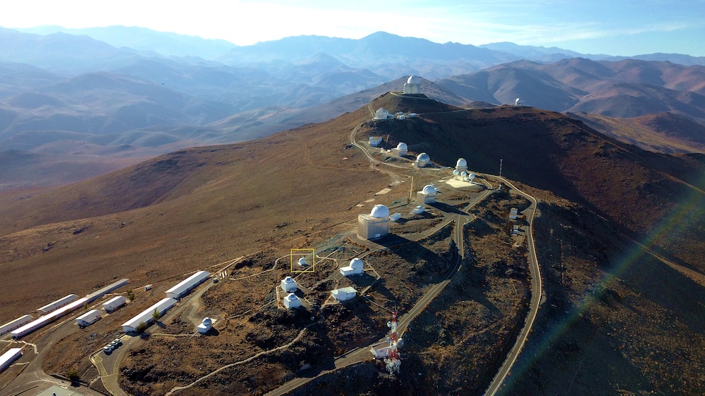
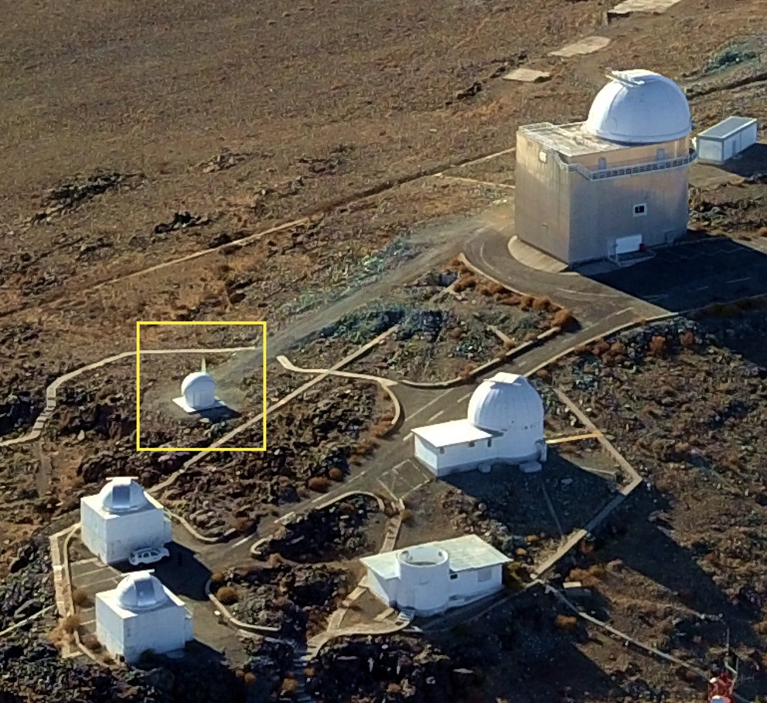
Test-Bed-Telescopes (TBTs)
2 TBTs now deployed: Cebreros Tracking Station (Spain) & La Silla (Chile)
56 cm telescopes with large FoV CCDs (2.5°×2.5°)
Main NEO use: low elongation surveys and large uncertainty follow-up

Slide 22
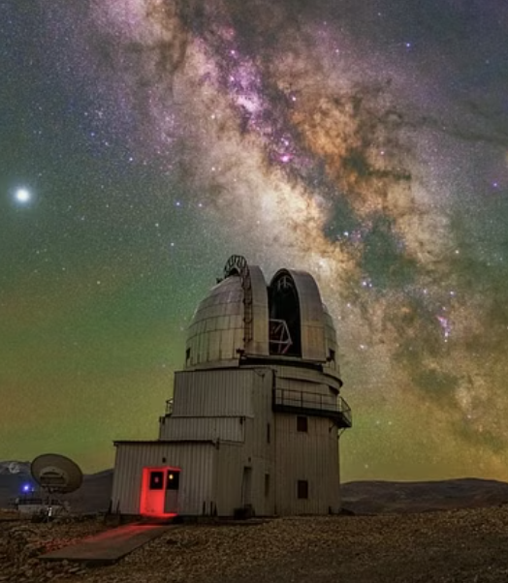
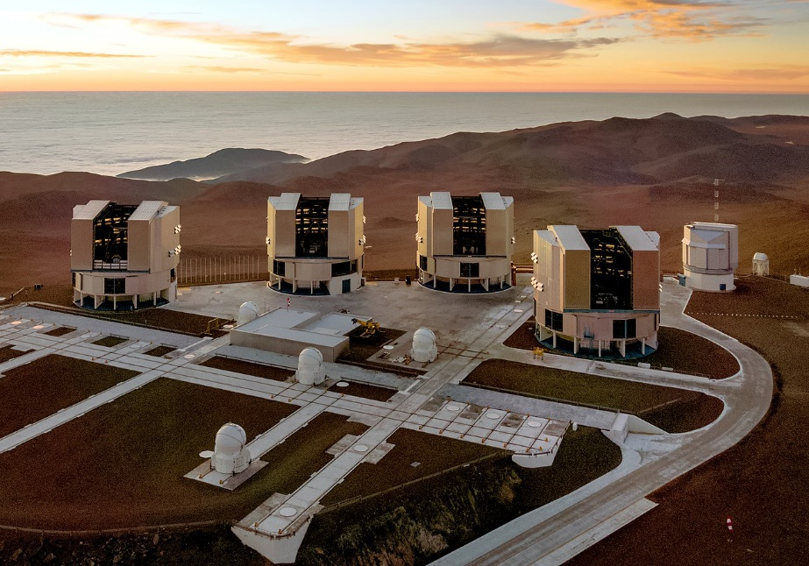
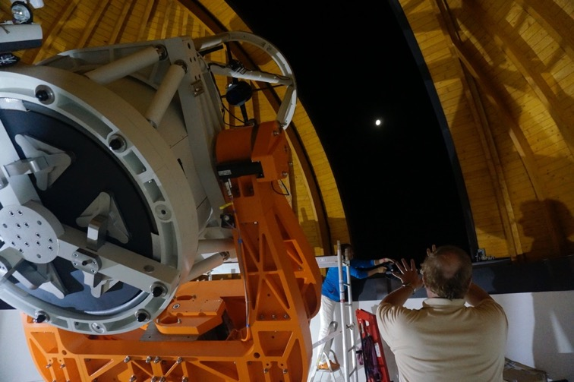
Follow-up
ESO/G. Hüdepohl
1-m Klet
Czechia
4x 8.2-m VLT
Chile
2-m Himalayan Chandra Telescope, India

Slide 23
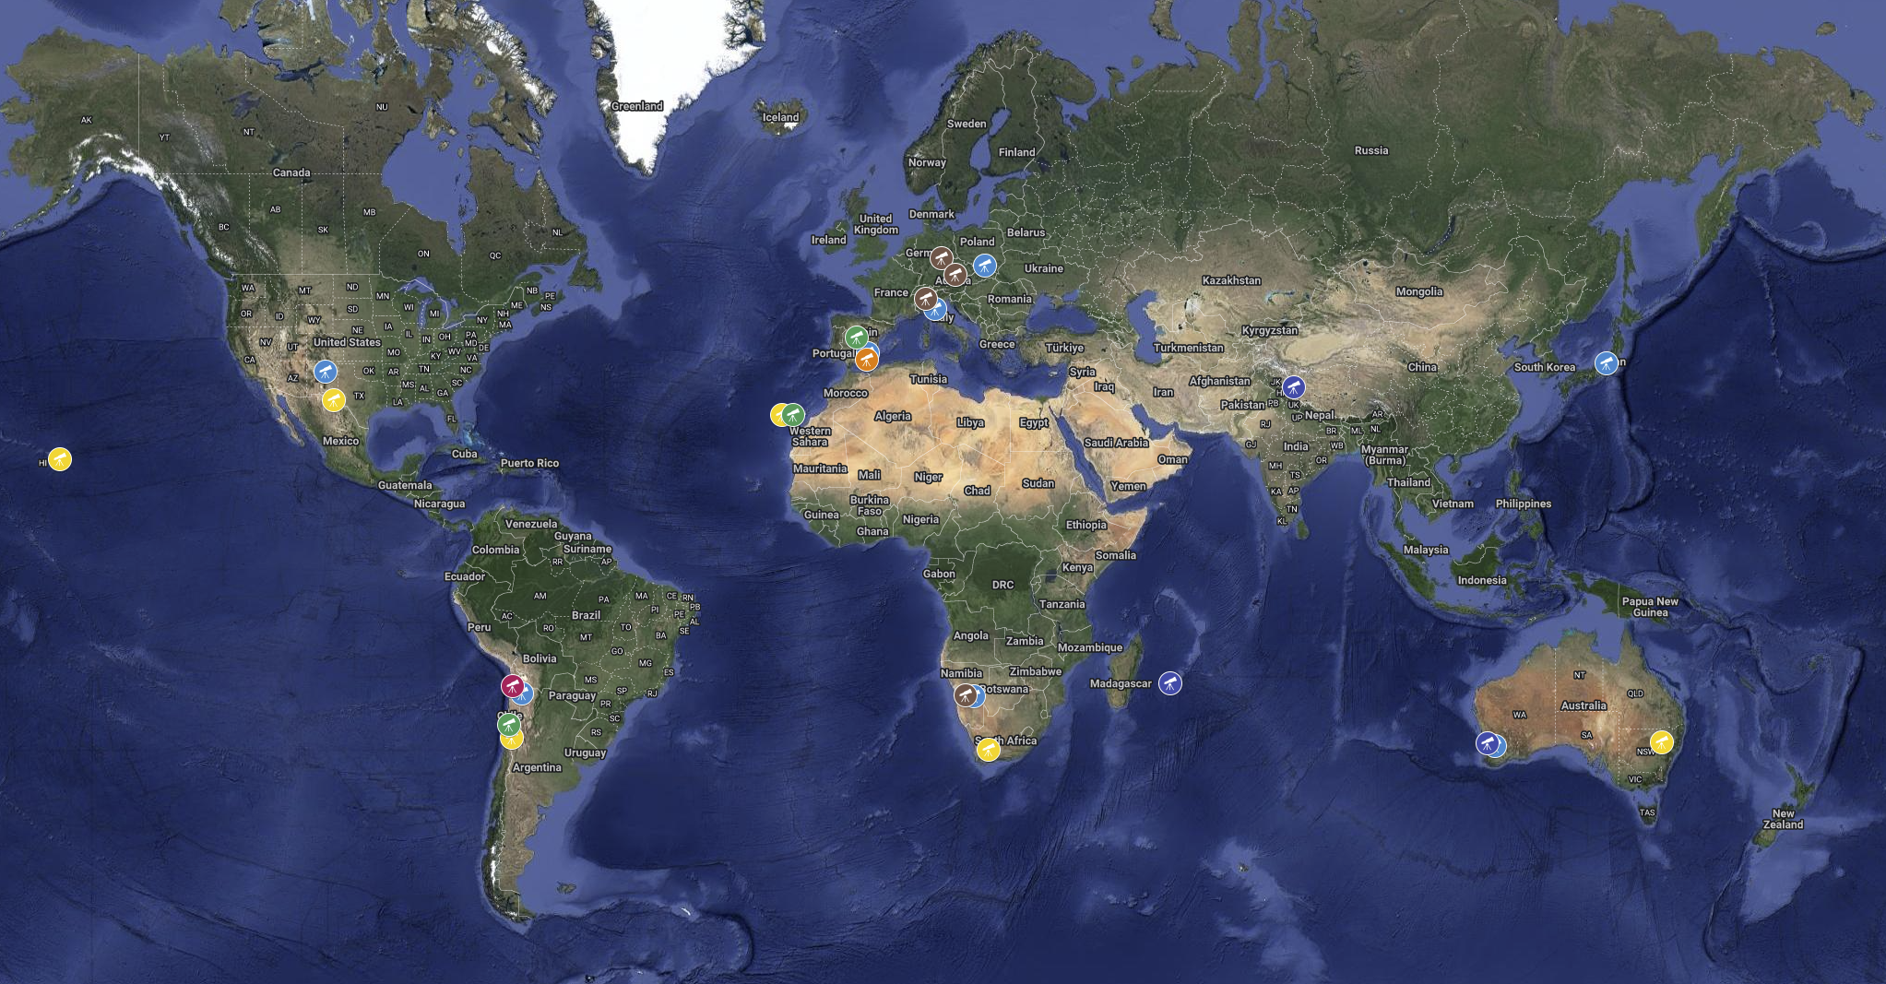
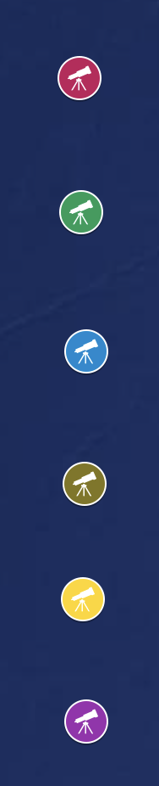
A wide telescope network
We developed a network of follow-up telescopes covering the entire planet.
Among the notable follow-up facilities we either directly use or support, we can mention:
ESA OGS (J04)
ESA TBTs (W57, Z58)
CAHA Schmidt (Z84)
LCO network
6ROADS network
Tautenburg (033)
Kleť (246)
Schiaparelli (204, M21)
Many of them are now leading follow-up facilities worldwide.
Legend
Scientific Agreement
ESA owned/funded
6ROADS
Southern Hemisphere
6ROADS Asia
LCO
Flyeye #1

Slide 24
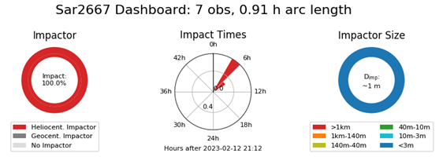
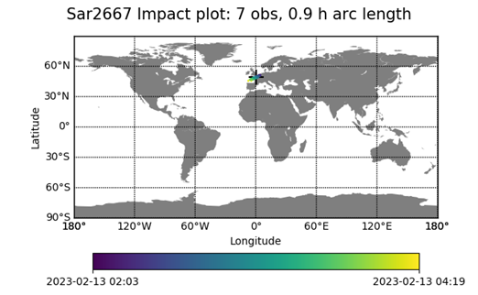
Global coverage for time-sensitive cases
Some observations, such as the rapid follow-up of imminent impactors, require the availability of telescopic resources with very little advance warning.
These telescopes need to be well understood to extract valuable data.
An example: the impact of 2023 CX1
The time between alert and impact is often very short: it is essential to plan the observing strategy, possibly even in advance!
Multiple observations from the same location are not helpful: it is useful to get parallax from various continents.
At least some observations need to have excellent timing, to “calibrate” the time dimension of the trajectory determination.
ESA / PDO

Slide 25
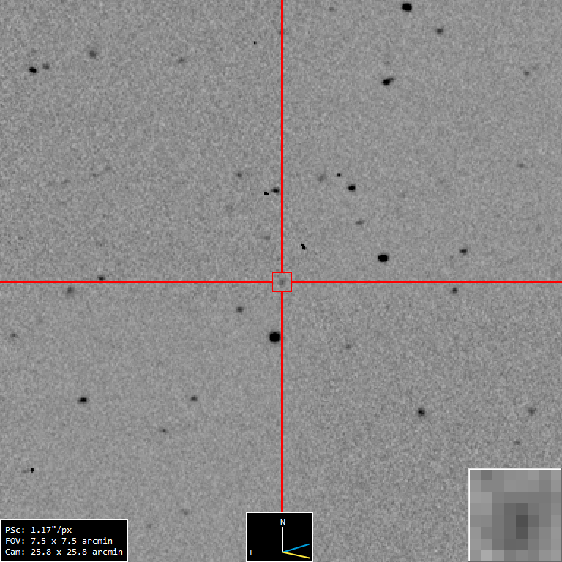
Constantly monitoring for opportunities
Our wide network allows us to react to observational needs that may not be otherwise doable from a single observatory.
We used facilities all over the world to collect high-precision, time-calibrated astrometry of the object, significantly reducing its impact probability.
An example: the fly-by of 2023 VD3
Highest rated object in our risk list when announced.
Solar conjunction <12 h after announcement.
Next observation chance... at impact!
Already a good orbit, and <12 h to improve it.
T. Santana-Ros & ESA / PDO

Slide 26
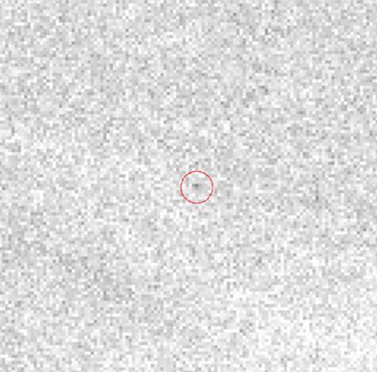
Covering the faintest targets
Impactors usually get fainter after discovery.
We routinely use ESO’s Very Large Telescope to observe faint (V~27) high-rated objects from our Risk List, and extract high-precision astrometry from the detections.
An example: follow-up of 2021 QM1
A high-rated impactor discovered one year earlier.
Recoverable at magnitude 27, but in challenging conditions.
Requires an 8-10 meter class telescope like VLT.
Object detected ⇒ Impact excluded.
At V~27.0, this is a good example of the faintest NEOs that can be observed.
(We later reached V~27.2 on another target)
ESO, O. Hainaut / ESA PDO

Slide 27
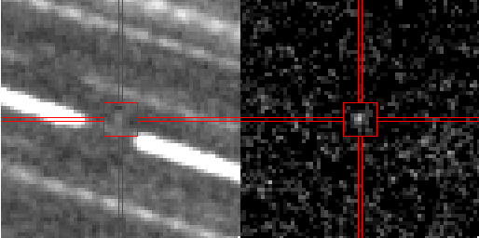
Going faint with smaller telescopes
In the upcoming LSST era, follow-up needs at magnitude V~24 will increase dramatically.
Is it possible to use smaller telescopes to detect these targets?
An example: follow-up of 2008 TD2
Using an 80 cm telescope
(Schmidt telescope at Calar Alto, Spain)
We could detect a V~24.2 asteroid.
Obtained with 5 hours of exposure time.
Stacking at variable rates is needed.
This mode of operation for a small-class telescope could offer interesting follow-up opportunities for faint objects typically only observed with larger professional facilities.
Calar Alto Observatory / ESA NEOCC

Slide 28
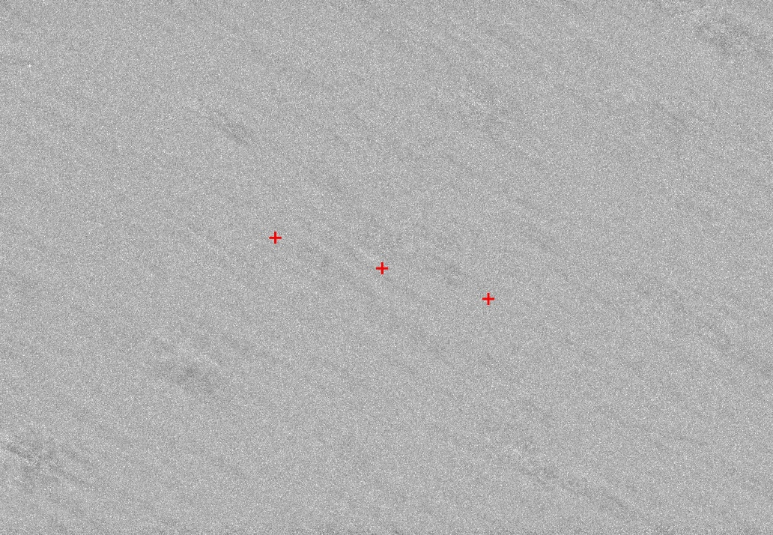
Developing new techniques
Not all objects we may want to observe are actually observable.
Moving objects can be lost, when we don’t know their orbit and ephemeris well enough.
In some cases when the objects are not recoverable, we need to use alternative methods:
An example: negative recovery of 2006 QV89
An upcoming high-rated impactor.
Difficult recovery with sufficient warning time.
We observed the location in the sky where impacting location would have appeared (marked by the red crosses + in the figure).
Object not detected ⇒ Impact excluded.
A proper protocol to ensure extended use of the same technique is being developed.
See Hainaut et al.; A&A, 653:A124 (2021)

Slide 29
Two major hardware improvements
Two new technologies are changing the way we obtain astrometry observations today:
CMOS sensors
These new sensors ensure extremely fast readout speeds.
Very little time is lost downloading frames.
It is now competitive to observe an object with many individual short frames (hundreds to thousands), instead of using longer individual exposures.
GPUs
It is now not uncommon to obtain many GBs of imaging data on a single target.
These images need to be combined, tracked on the motion of the asteroid.
If we know the motion, we can stack images in seconds.
If we don’t, we can test all motion vectors (synthetic tracking).

Slide 30
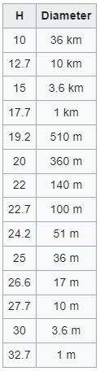
HOW IS THE SIZE DETERMINED?
Astronomers also provide a measurement of the magnitude of the asteroid observations to MPC
Those are useful to determine the so-called absolute magnitude (H)
The absolute magnitude is a technical proxy of the asteroid side
However, such approximation depends on the reflectivity of the body:
  Bright objects reflect more visual energy (high albedo)
  Dark objects reflect less visual energy (low albedo)
CNEOS Asteroid Size Estimator

Slide 31
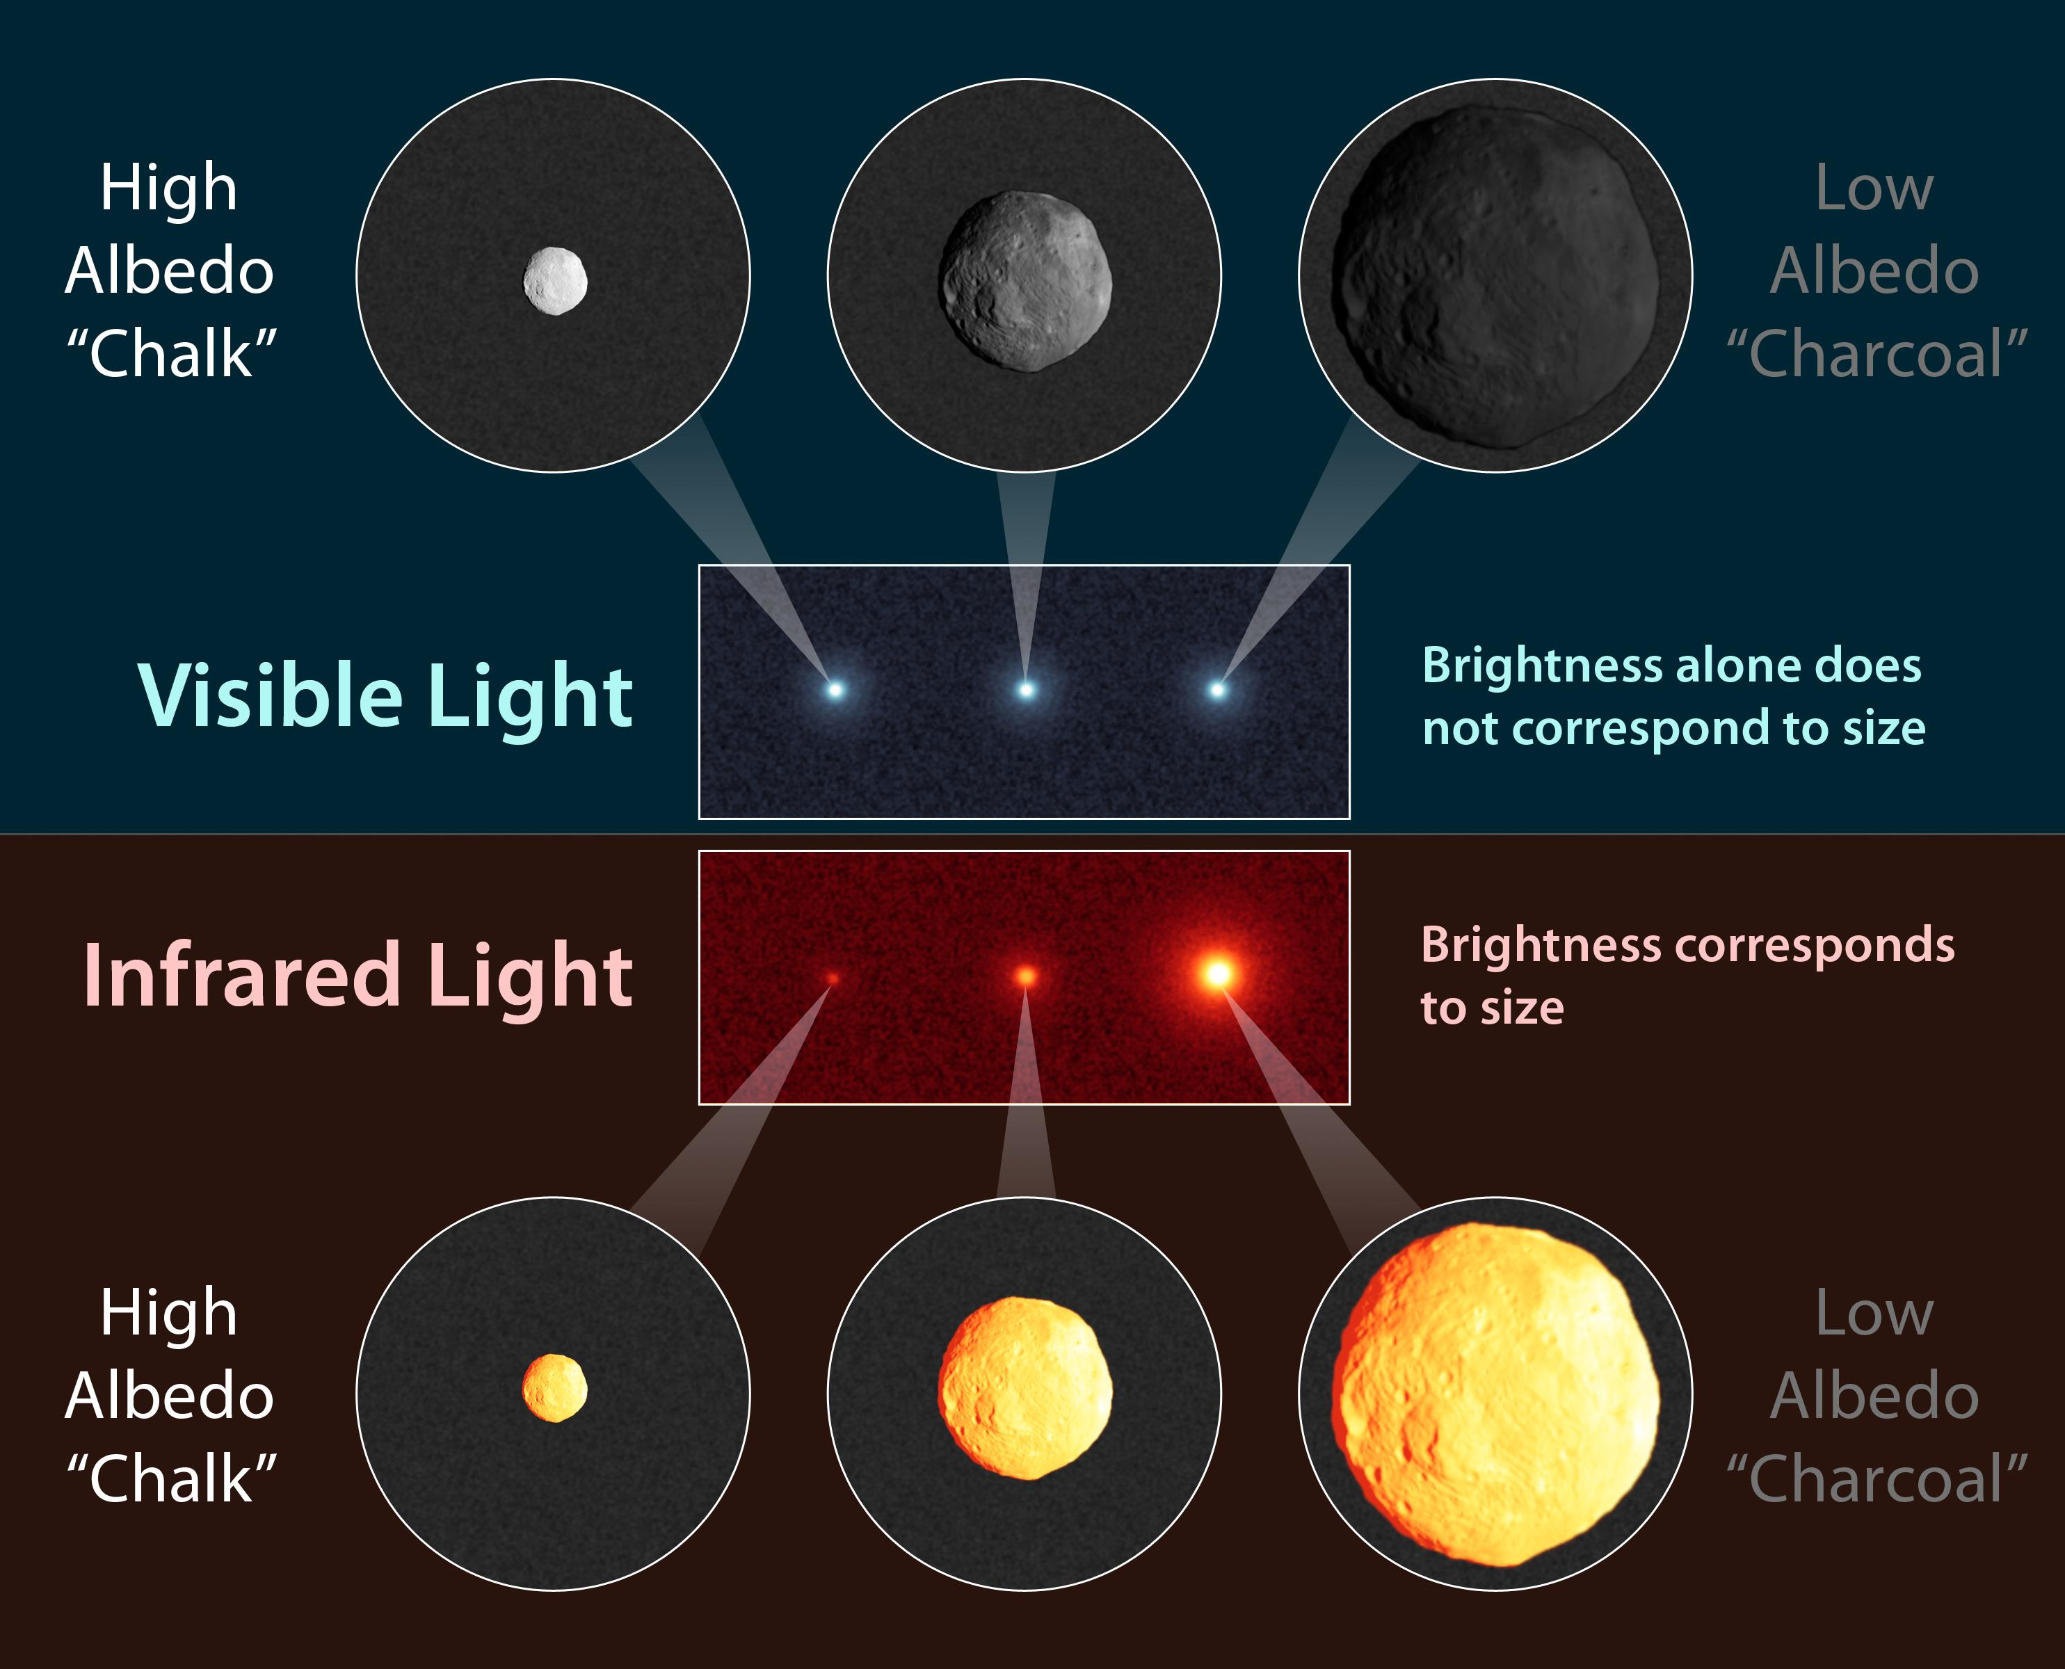
Problems in Size Determination
Reflectivity (albedo) is highly variable and very much dependent on the composition of the object (taxonomy):
  Carbonaceous objects are very dark (albedo smaller than 5%)
  Silicate objects are average (albedo 15-25%)
  Metallic objects can have high albedo (larger than 50%)
Infrared measurements can substantially help in solving that issue, although they have to be mostly performed from space
Up to 15% of the asteroids are double objects
Shapes can be largely irregular (variable lighcurve)
Credit: NASA / WISE

Slide 32
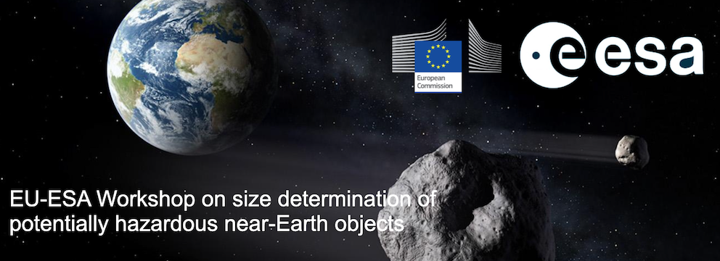

Advertisement:
November 11 – 13 2024 at ESOC (Damstadt, Germany)
https://indico.esa.int/event/530/

Slide 33
Physical characterization
Obtaining physical characterization observations of an NEO is extremely important not just for scientific goals, but also for planetary defense purposes.
Taxonomical classifications, either via color photometry or spectroscopy, provide direct evidence of the compositional properties of a possible impactor, and can indirectly constrain key parameters such as density, tensile strength that are essential to predict ground effects.
Rotational lightcurves and period determination provide shape information, and indirectly help constrain the internal strength of the object.
Infrared measurements can directly measure albedo and size of an object, possibly the most important observable quantity to assess its impact threat.
Polarimetry can indirectly determine the albedo of a body, significantly improve size and impact energy determination.

Slide 34
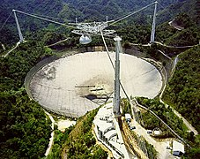


Radar follow-up
When mentioning follow-up observations we should not forget the importance of radar observations.
With the loss of Arecibo, the NASA DNS facilities are now the main providers of NEA radar detections and range / doppler astrometry.
The use of bistatic configurations, receiving with other large aperture antennas (e.g. Green Bank) is now getting more common, and allows for additional observational opportunities.
H. Schweiker / WIYN / NOAO / AURA / NSF
NASA / JPL
NRAO / AUI / NSF

Slide 35



ESA’s Planetary Defence Plans for the Future
Strengthen international
collaboration and networking
Closing
observational
gaps
Informationen bereitstellen
“Information Provision”
Enhancement and
upgrade of capabilities
Fast Asteroid Reconnaissance
and deflection

Slide 36


NEOMIR (2032+)

Slide 37




Information Provision – Public Tools

Slide 38

Thank You!
https://neo.ssa.esa.int
Special Thanks to:
Marco Micheli, Dora Föhring, Luca Conversi, Francisco Ocaña, Rainer Kresken

