Slide 1


Slide 2
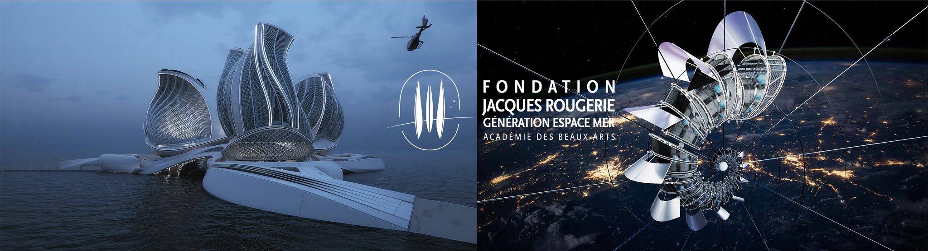
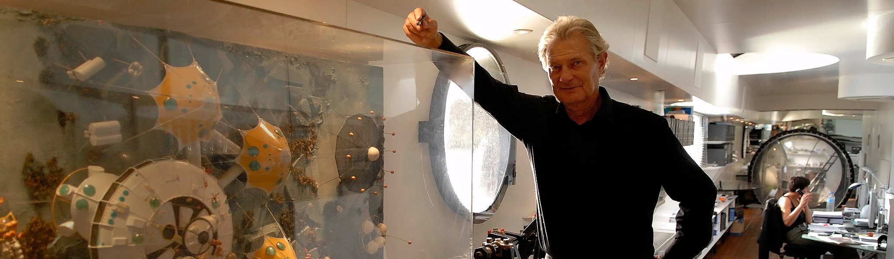
Notes:
This concept was developed for the competition organised by French Jacques Rougerie Foundation.

Slide 3
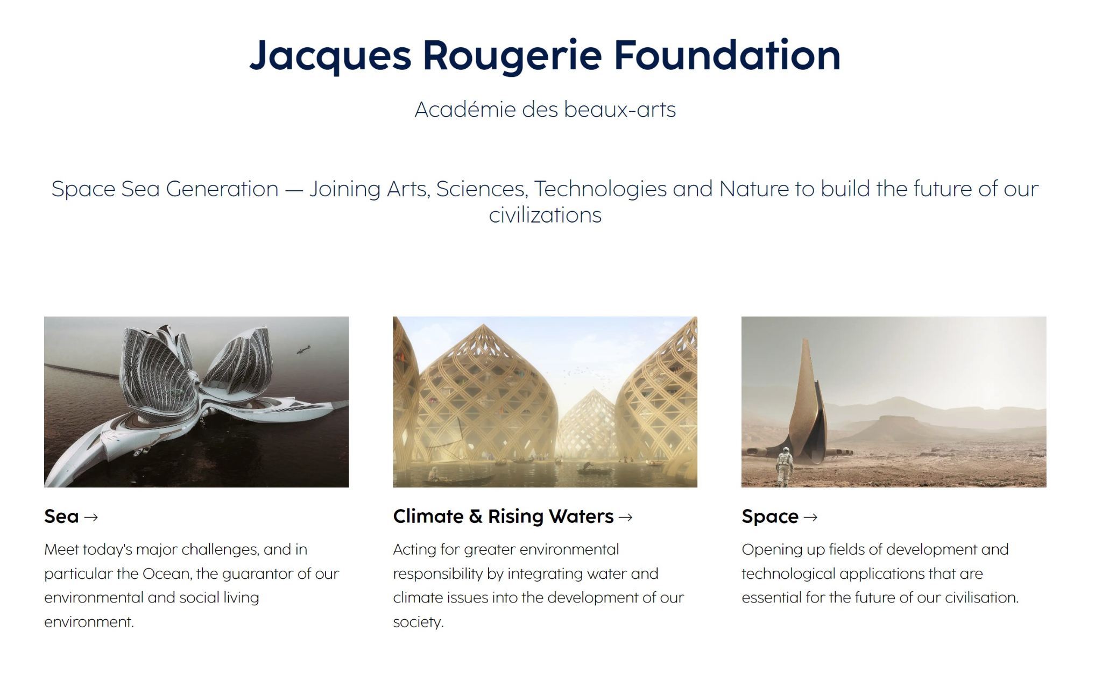
Notes:
Once a year, the foundation invites creative people to combine art, science, technology and nature to build a better future for everyone. There are three topics, ocean protection, the fight against climate change and space development.

Slide 4
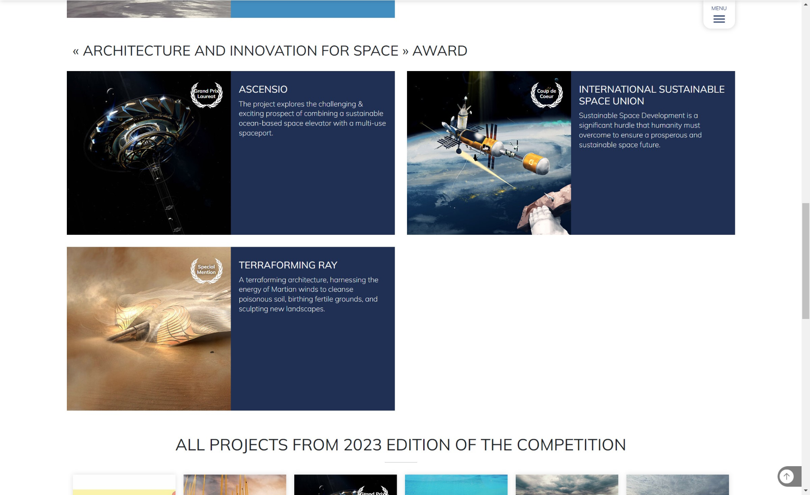
Notes:
My concept, "International Sustainable Space Union" was one of the three awarded works in the "Architecture and Innovations for Space" category.

Slide 5
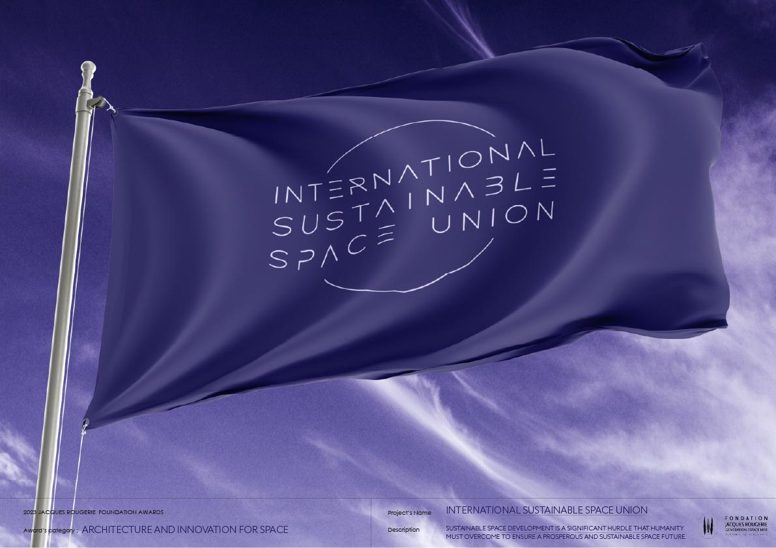
Notes:
The "International sustainable space union", ISSU in short, is imagined as an organization similar to the UN which would deal with legal and political space issues of all countries on the planet, especially related to problems that require bilateral cooperation. It would also maintain the infrastructure in the Space with the aim of sustainable development and cooperation in the Universe.

Slide 6


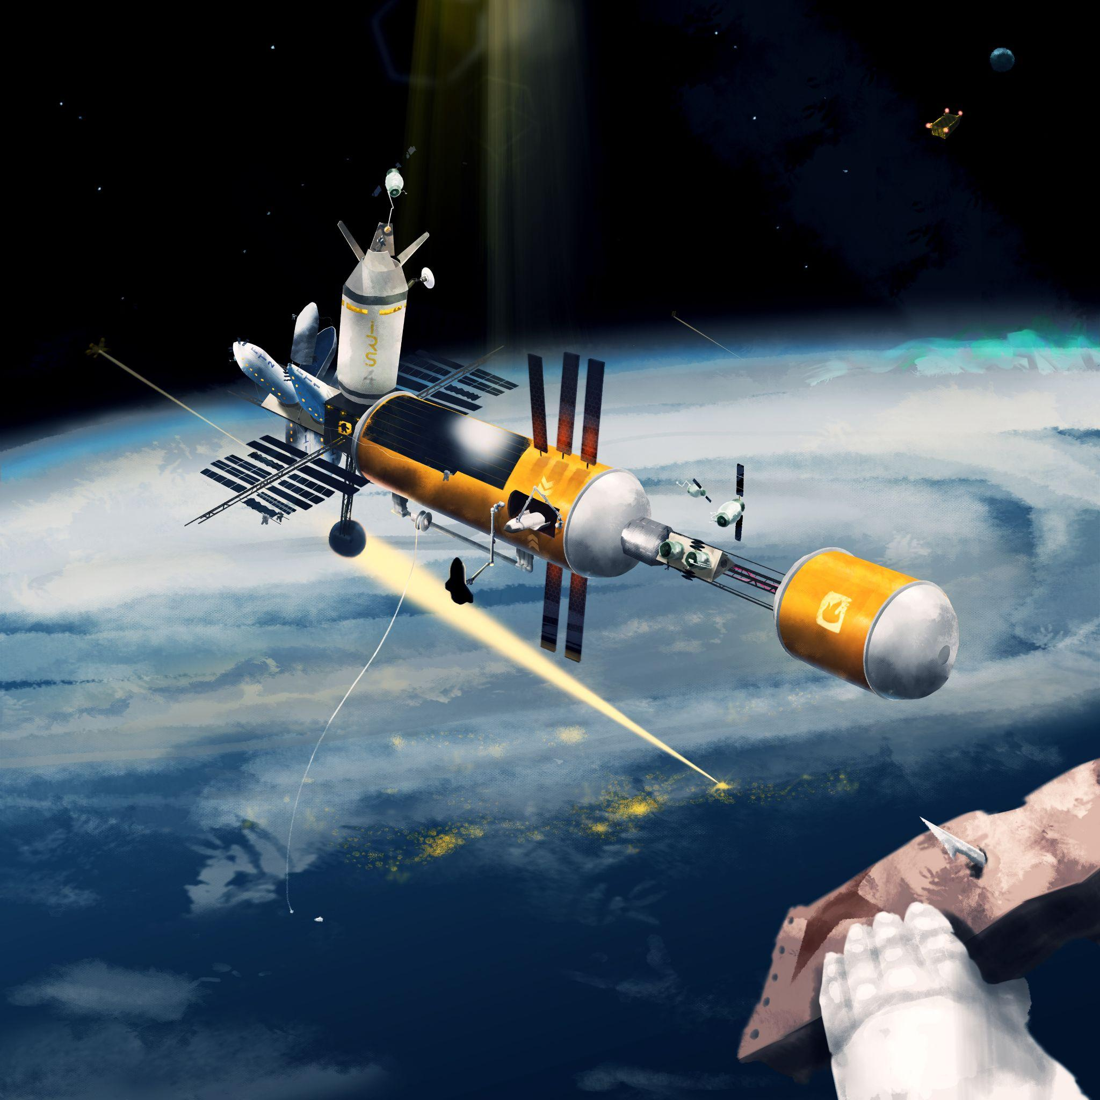
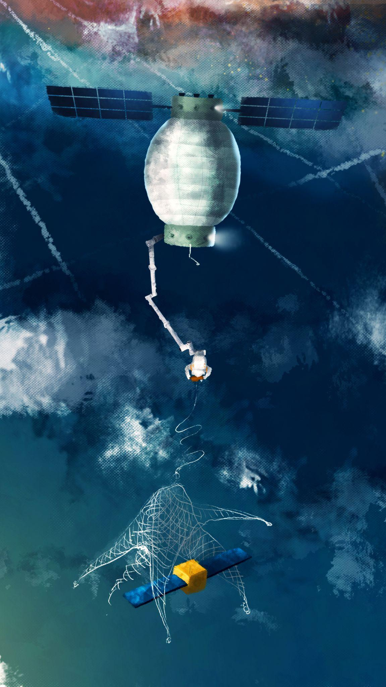
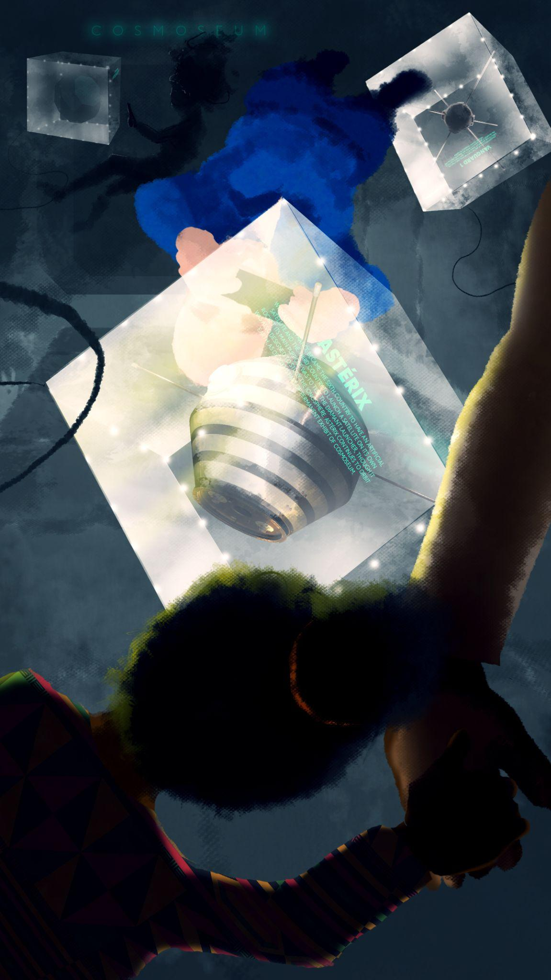
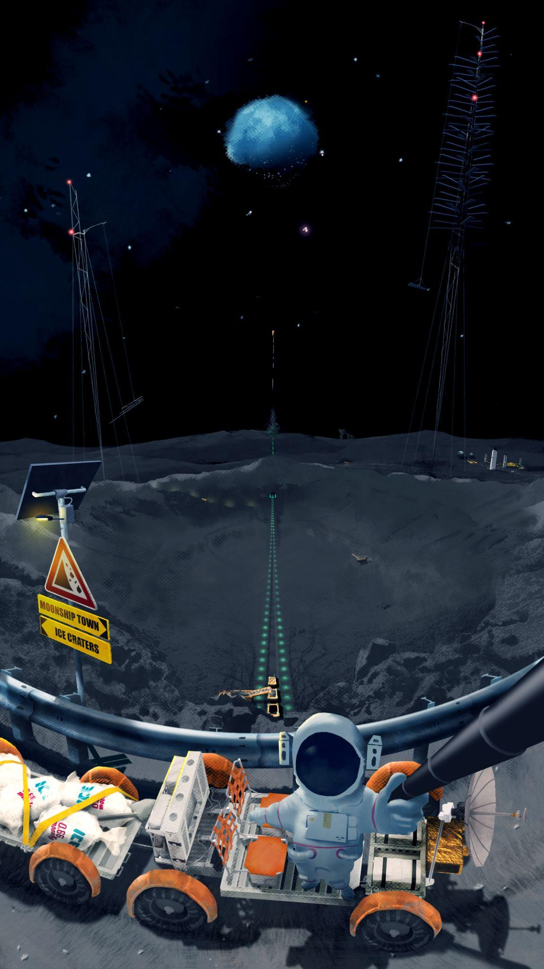
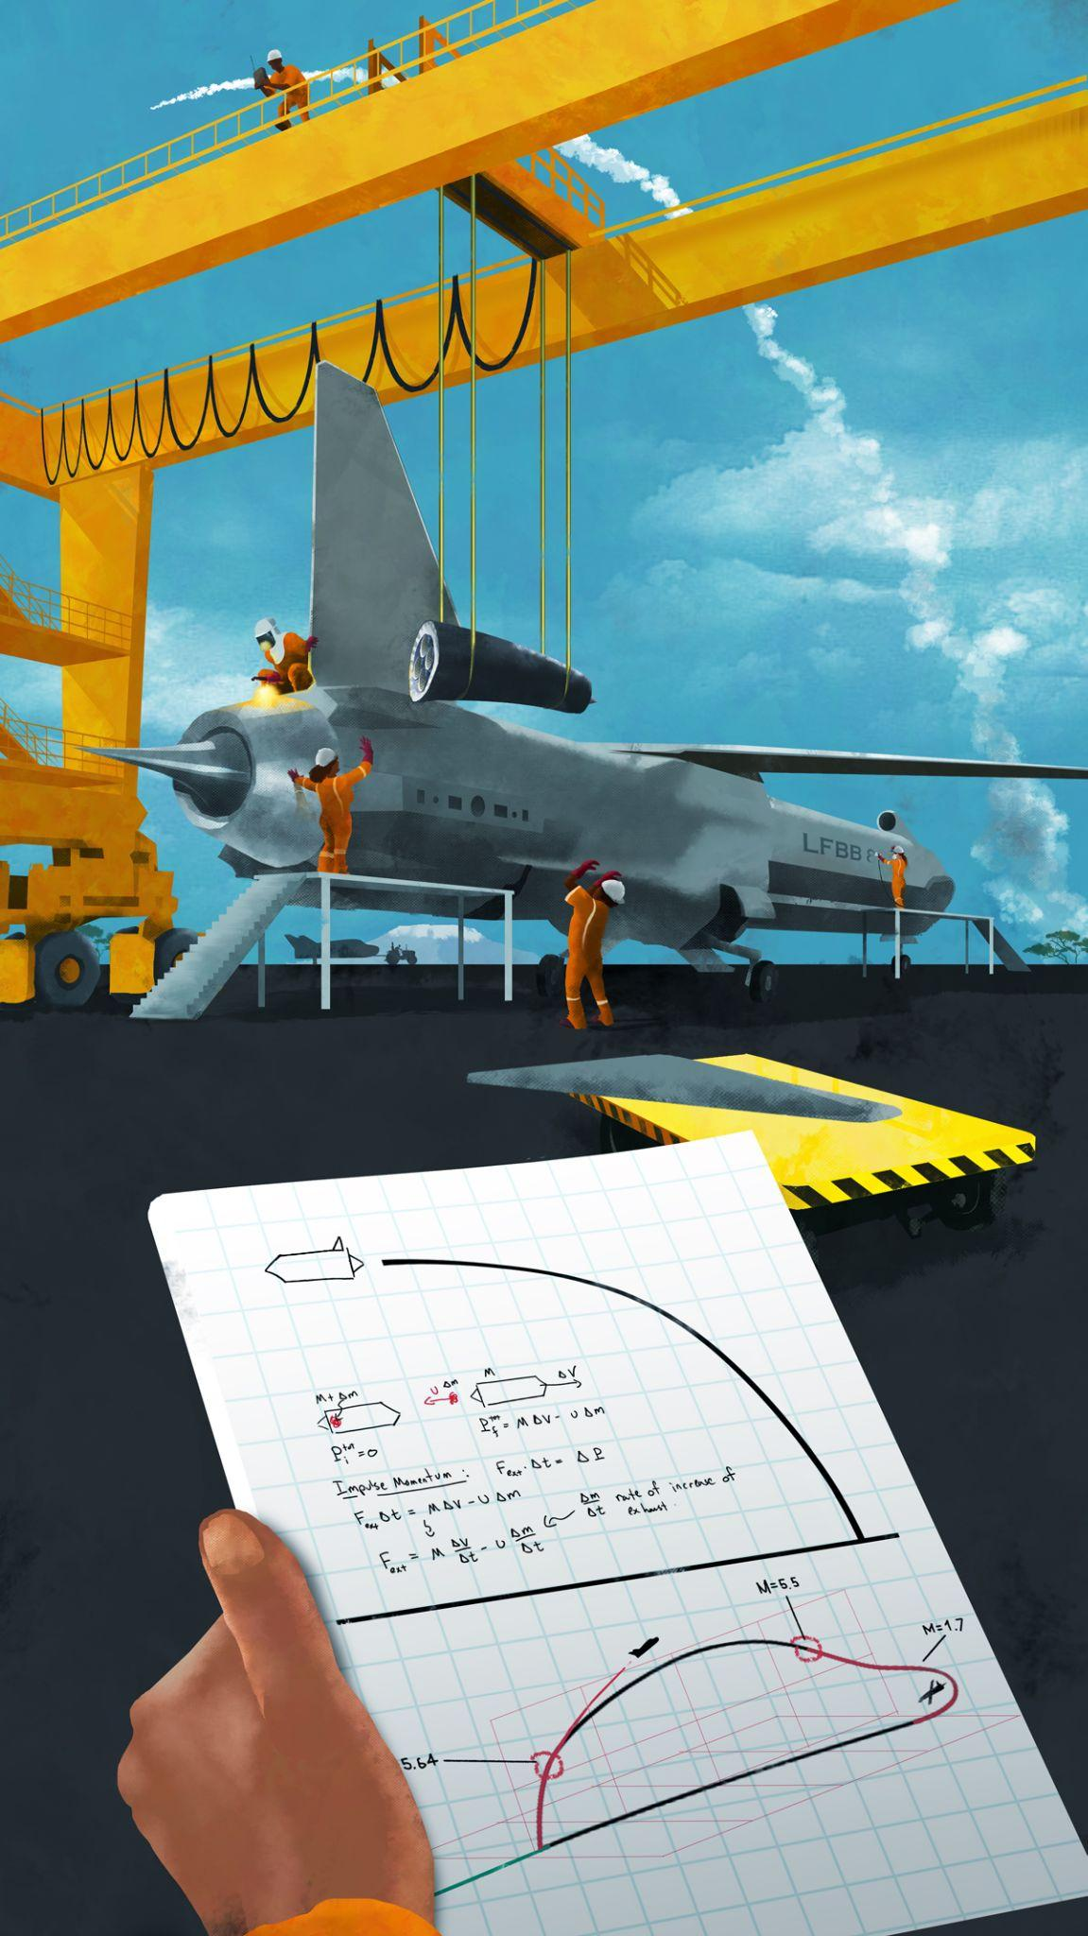
PROBLEMS
Notes:
Some of the challenges that my concept tackles.

Slide 7
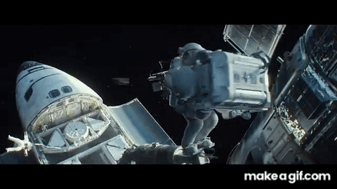
KESSLER SYNDROME
Notes:
Real threat to human Space ambitions, cascading debris field orbiting earth, preventing launches to space.

Slide 8
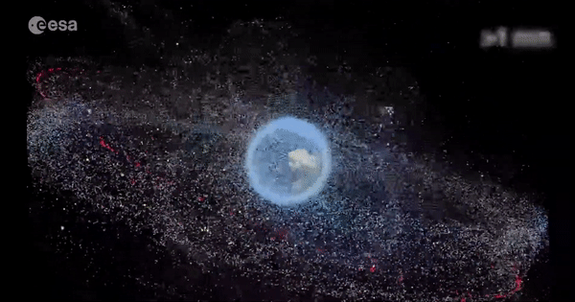
SPACE ECOLOGY
Notes:
Number of satellites, and "dead" satellites in orbit is impressive. There is a part of the orbit that is literally called the "graveyard". My work suggests a way to deal with this problem.

Slide 9
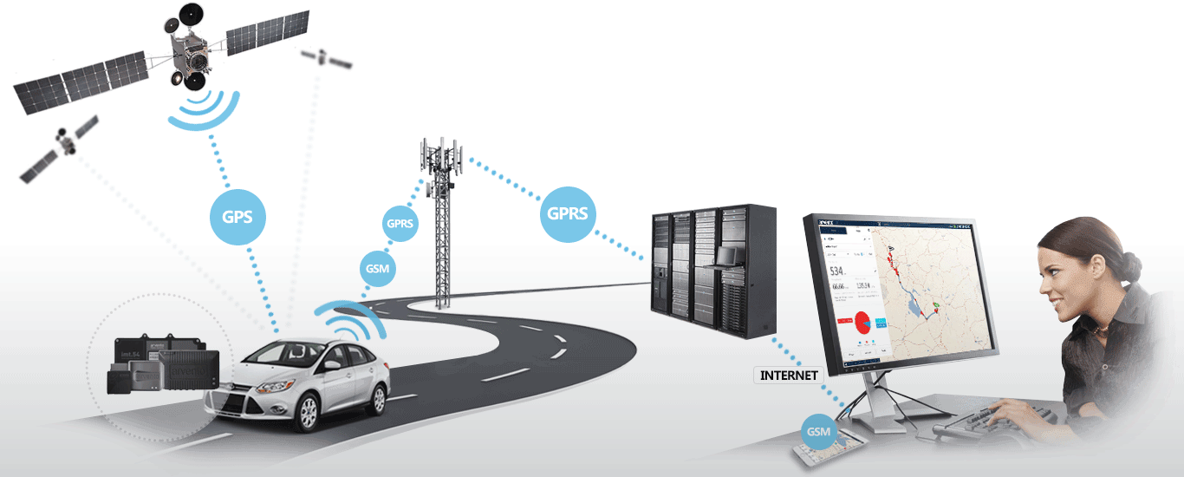
SPACE ECONOMY
Notes:
Everyone who owned a satellite dish, ordered lunch through one of the apps or followed the weather forecast, participated in the space economy. My concept proposes additional economic activities in Space.

Slide 10
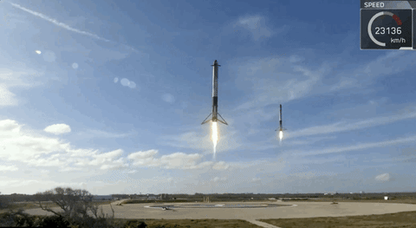
REUSABILITY
Notes:
The SpaceX has made a huge step forward in the direction of reusability of rockets, my paper proposes an additional method of full reusability.

Slide 11

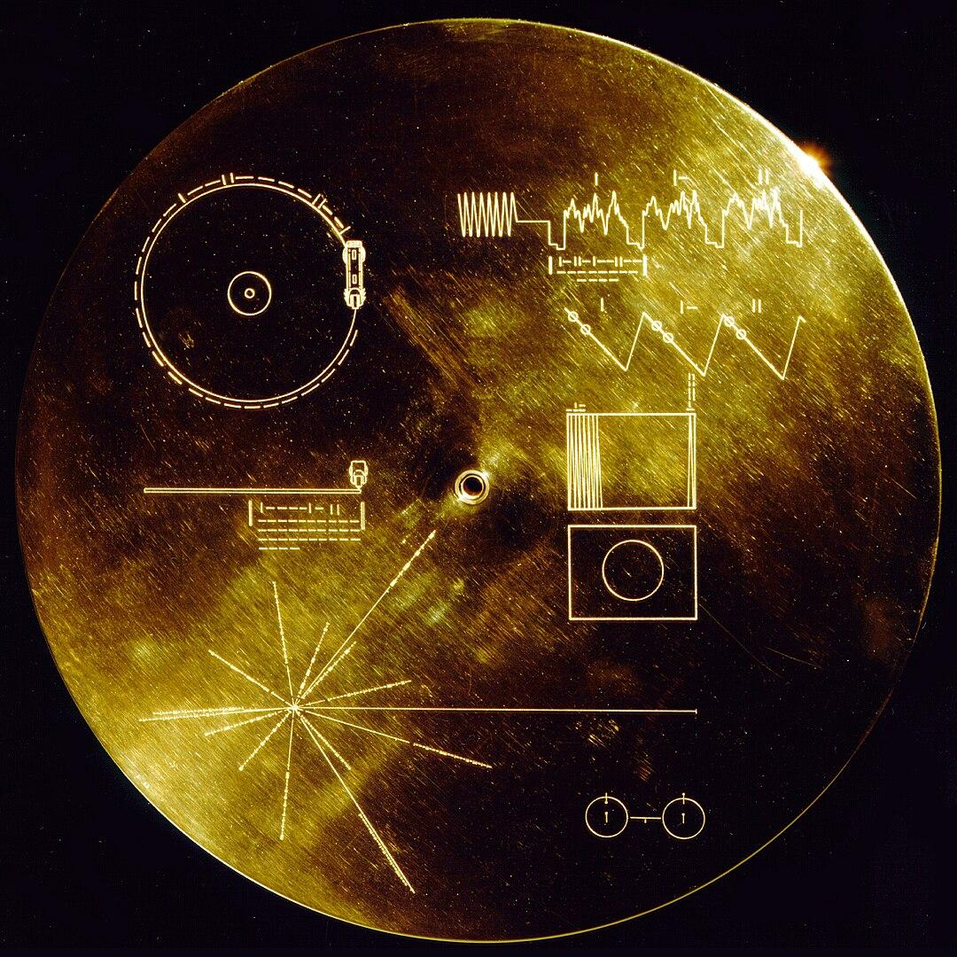
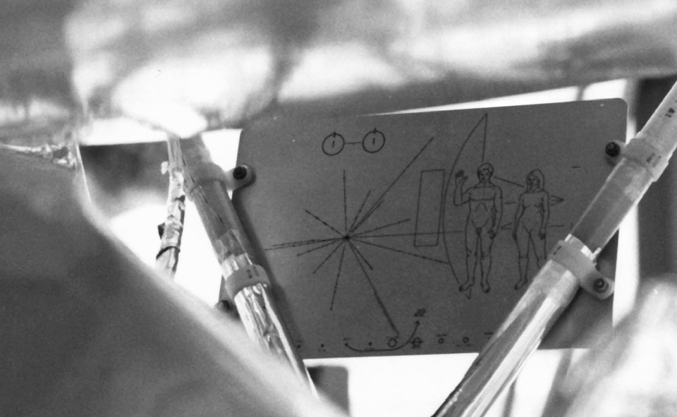
SPACE CULTURE
Notes:
This golden disc is attached to a probe sent to explore the far corners of the solar system and beyond. It has an engraved message intended for hypothetical extraterrestrials who could come across the probe in a million years and decipher the message. My work proposes a space culture for humans today, not just for aliens in a million years.

Slide 12
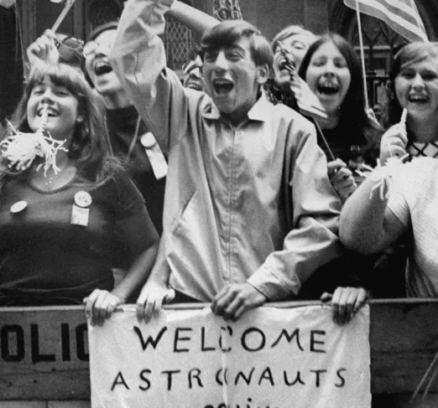
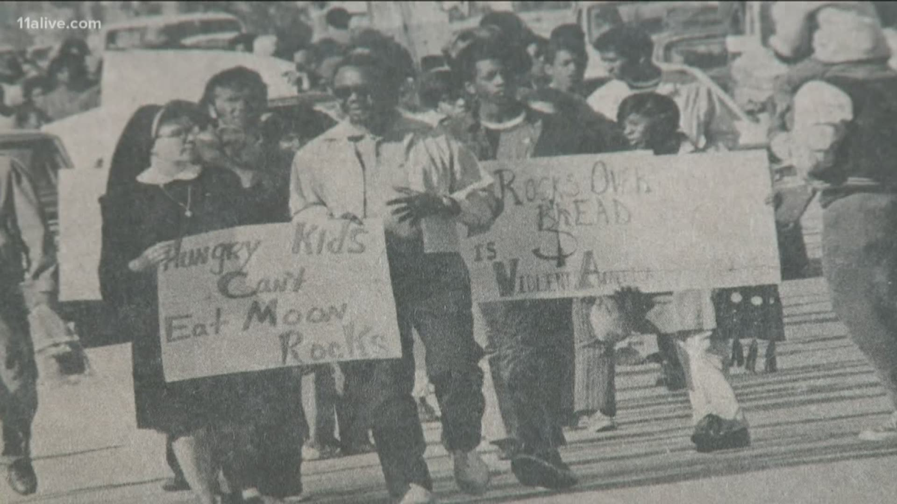
SPACE POLITICS
Notes:
Space exploration has always been a divisive topic. Some think that it is the ultimate achievement of human civilization, others that it is a pointless expense. My work also addresses the question of the meaningfulness of the development of space culture and technology.

Slide 13
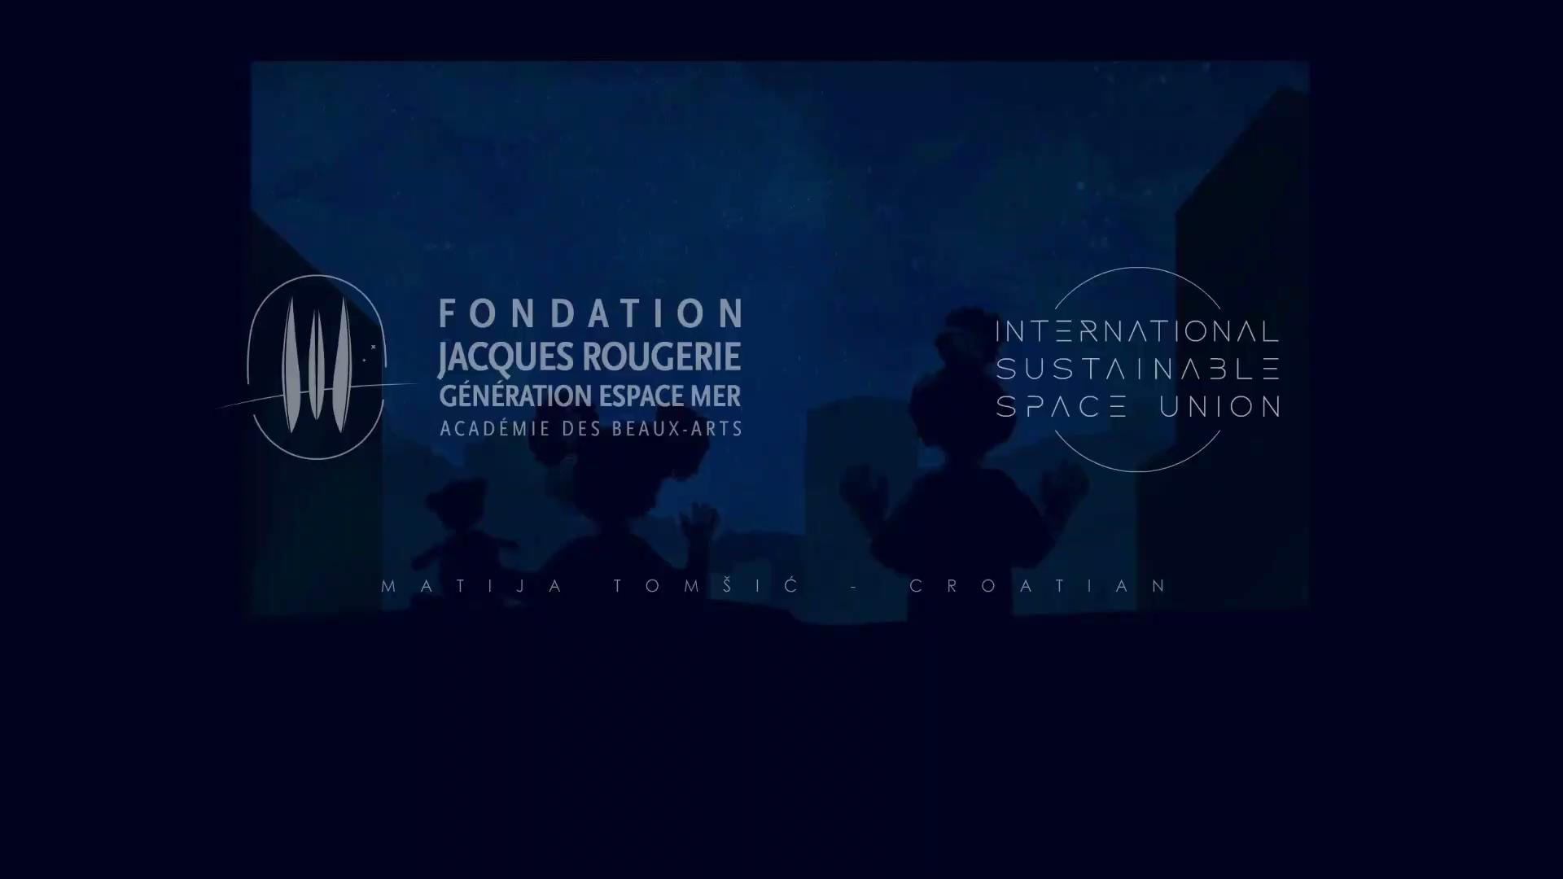
Notes:
First, a short film.

Slide 14
NETWORK
OF STATIONS
MADE FROM RECYCLED ROCKETS
CLEAN ORBIT
CLEAN ENERGY
SUSTAINABLE SPACE TRAVEL
OFF-EARTH INDUSTRY
WEATHER CONTROL
LIVING IN SPACE
SPACE TOURISM
SPACE CULTURE
Notes:
The main component of the Space Infrastructure would be a network of space stations in low Earth orbit. The main structural elements, as seen in the example of this station, would be recycled rocket parts. The central orange part is made from the main fuel tank of the rocket that NASA has been sending to the Moon recently. The main activities that the stations would deal with are clean energy production, weather control, orbit cleaning, sustainable access to space, transfer of industry to orbit, continuous habitation of orbit, space tourism and space culture.

Slide 15
Notes:
In my vision, energy would be generated by the solar panels that would be produced at the stations from material shipped from the Moon.
Fleet of inflatable crafts would hunt for dead satellites, and clean the Orbit.
Stations would serve as refueling station, making Space travel cost-effective.
Stations would house a Space museum, and promote a Space tourism.

Slide 16
Notes:
The energy would be transmitted to the ground by laser or microwaves. Recently, a university succeeded for the first time in transferring a small amount of energy from orbit to earth, proving this concept.
Travel to and from stations would be conducted by spaceplanes.

Slide 17
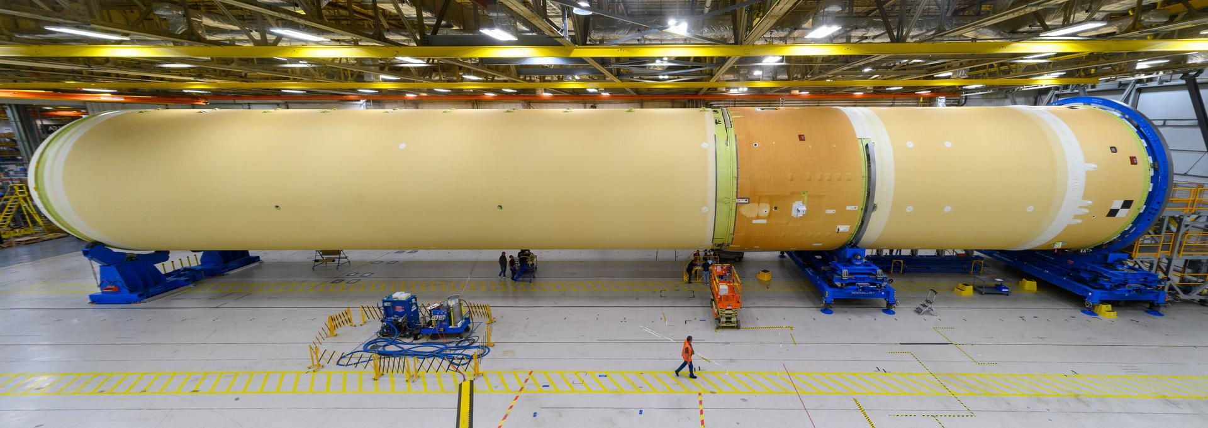
Notes:
My art is fictional, but is based on reality.

Slide 18
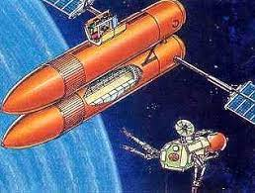
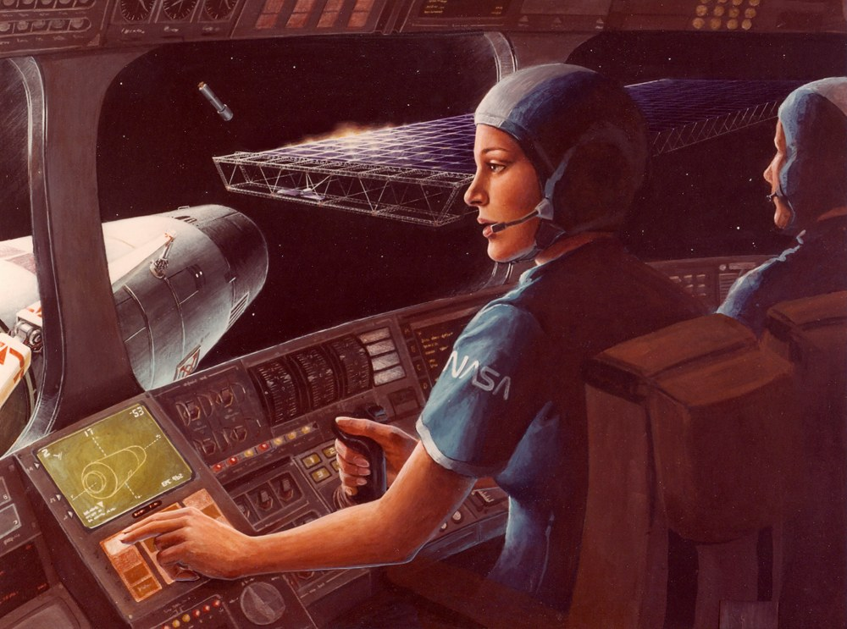

Slide 19
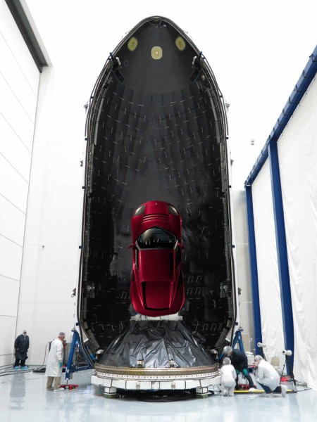
Notes:
Rocket components are usually quite big, and could be reused for other purposes than just launching stuff to orbit.

Slide 20
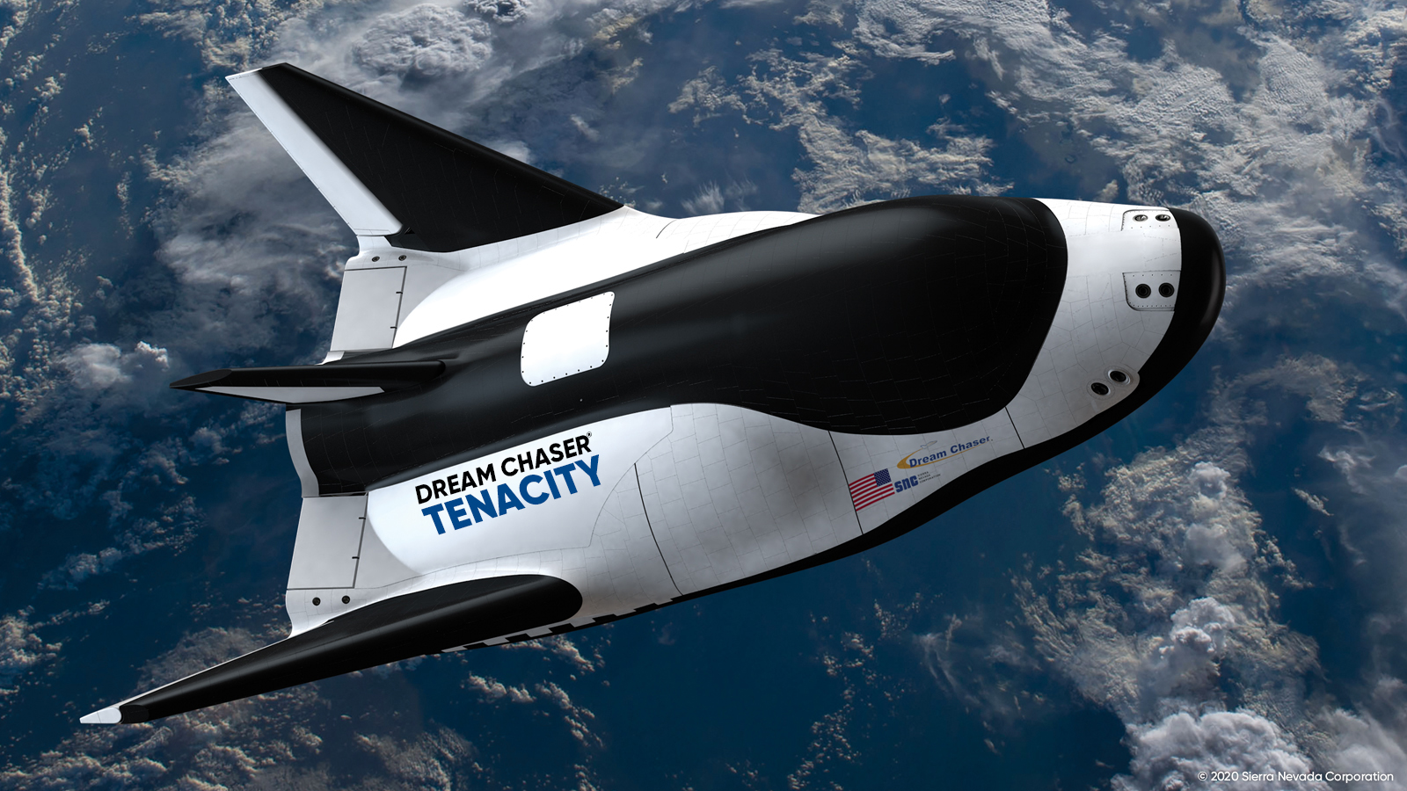
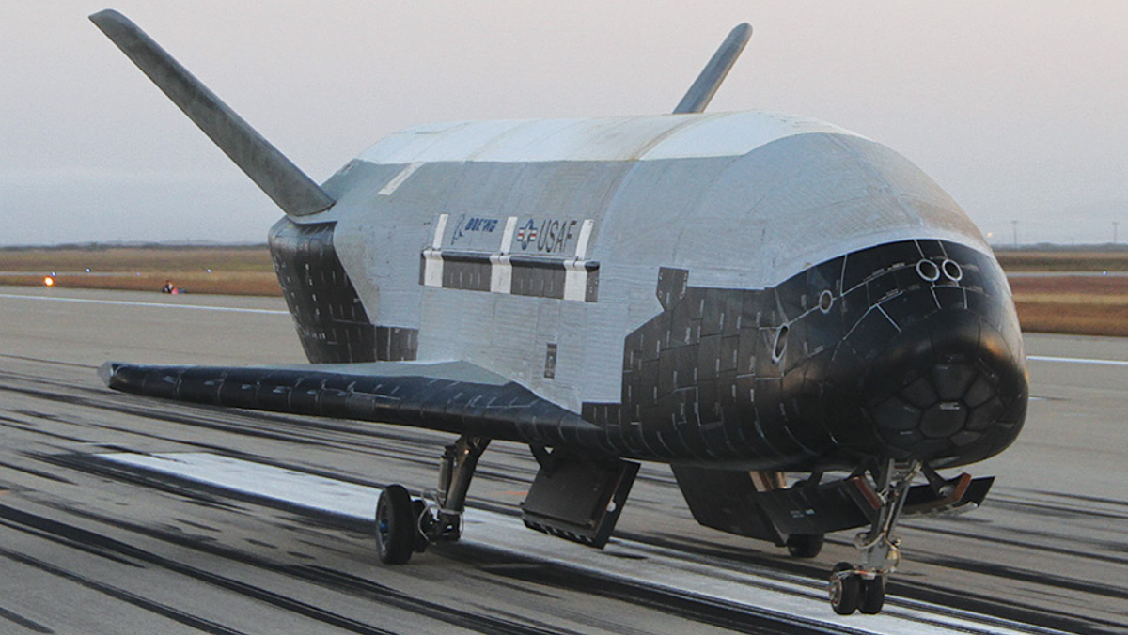
Notes:
Space plane technology is also developing quite well.

Slide 21
ISSU
JUNK HUNTERS
CLEAN ORBIT
SUSTAINABLE SPACE TRAVEL
OFF-EARTH INDUSTRY

Slide 24
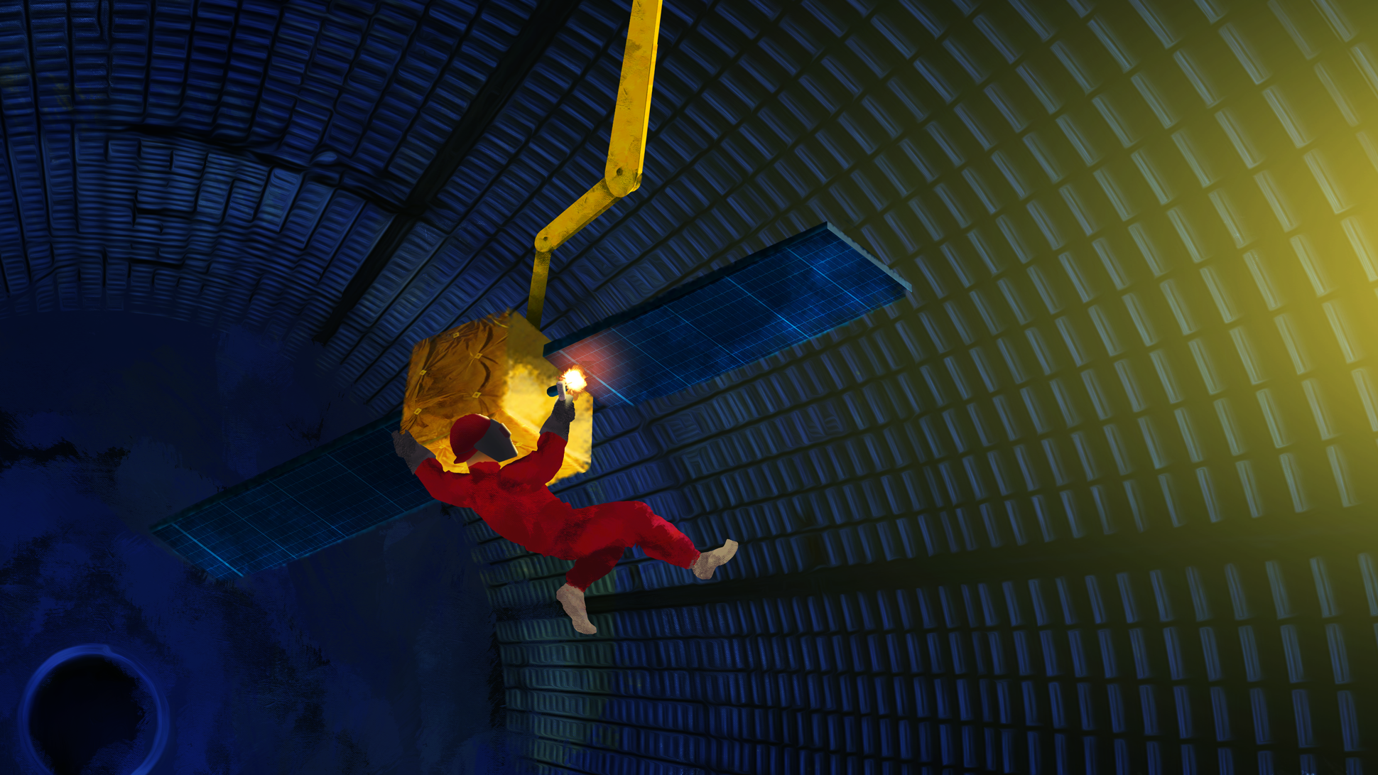

Slide 25
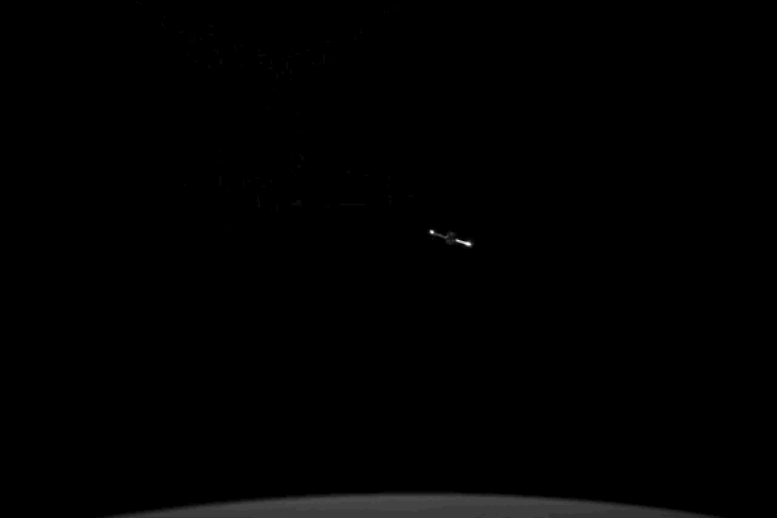

Slide 26
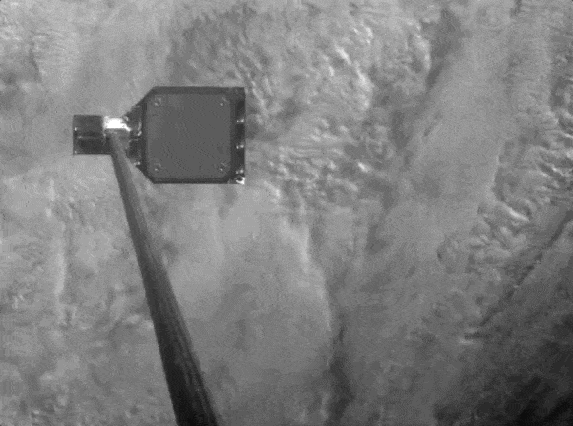

Slide 27
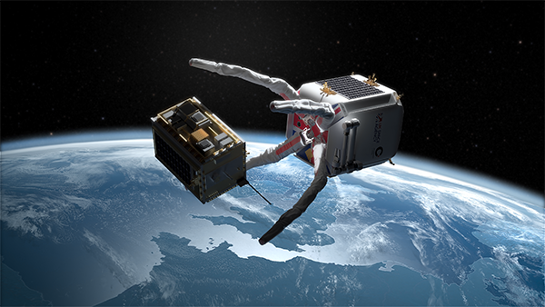

Slide 28
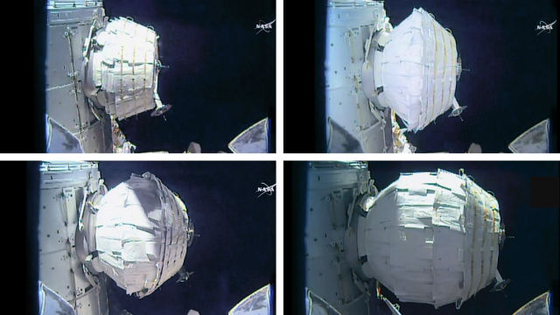

Slide 29
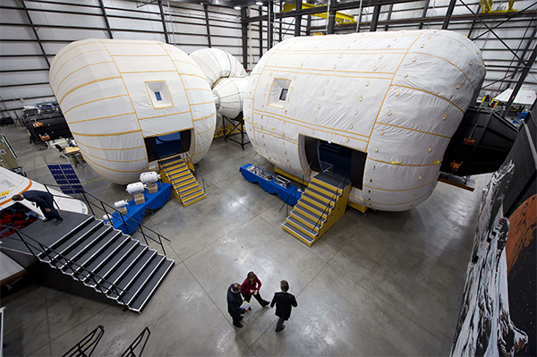

Slide 30
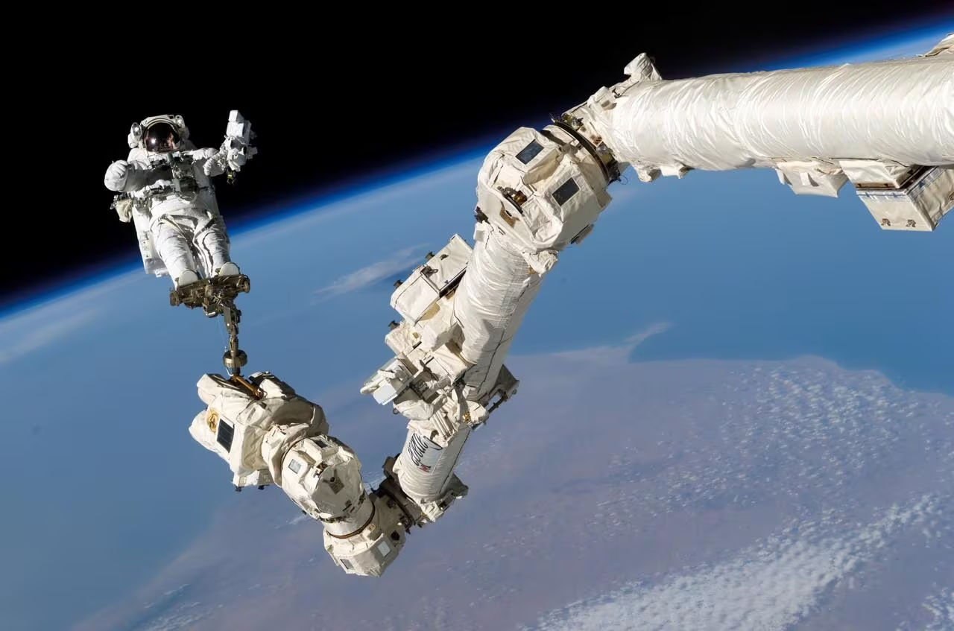

Slide 31
ISSU
COSMOSEUM
SPACE CULTURE
SPACE ARCHEOLOGY
SPACE TOURISM

Slide 33
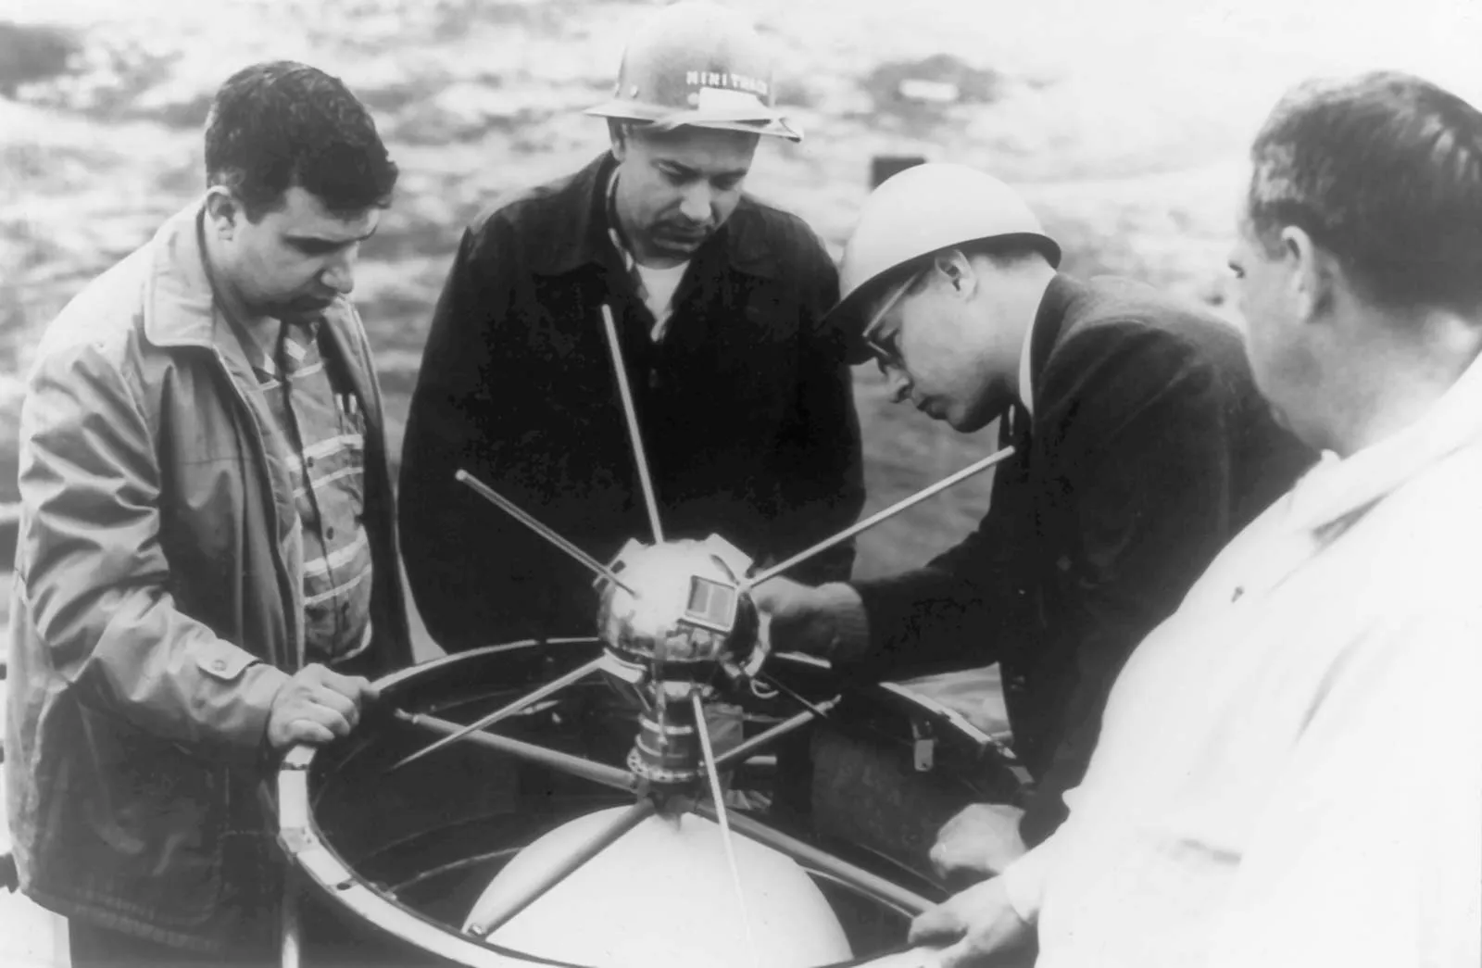
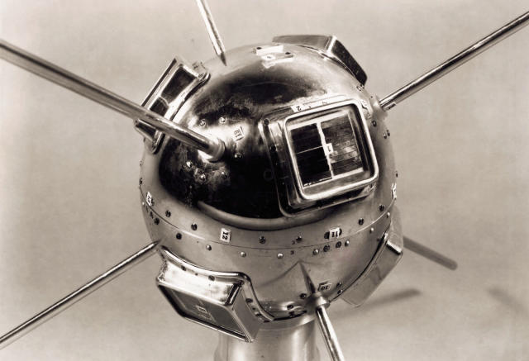

Slide 34
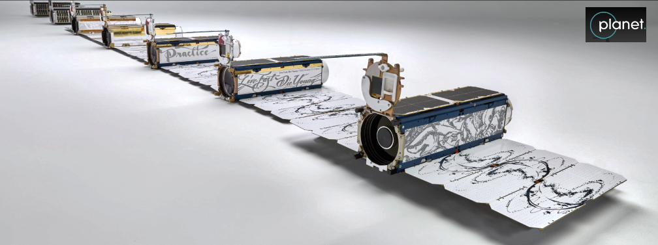

Slide 35
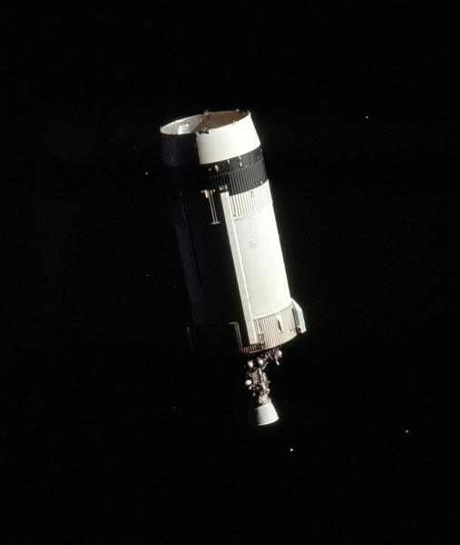

Slide 36
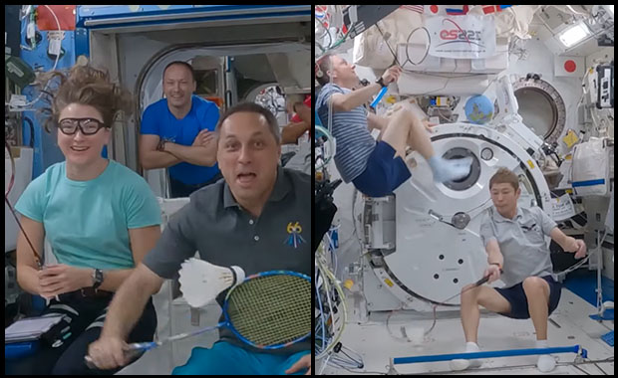

Slide 37
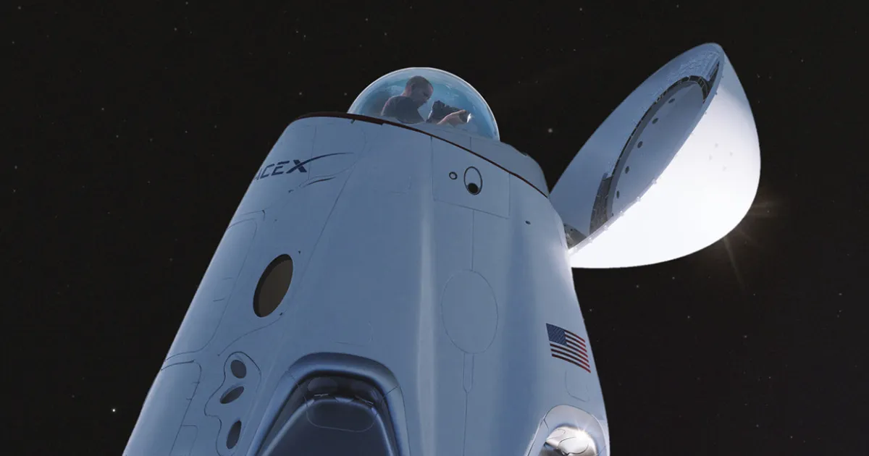

Slide 38
ISSU
COOPERATION BOOSTER
SUSTAINABLE SPACE TRAVEL

Slide 39
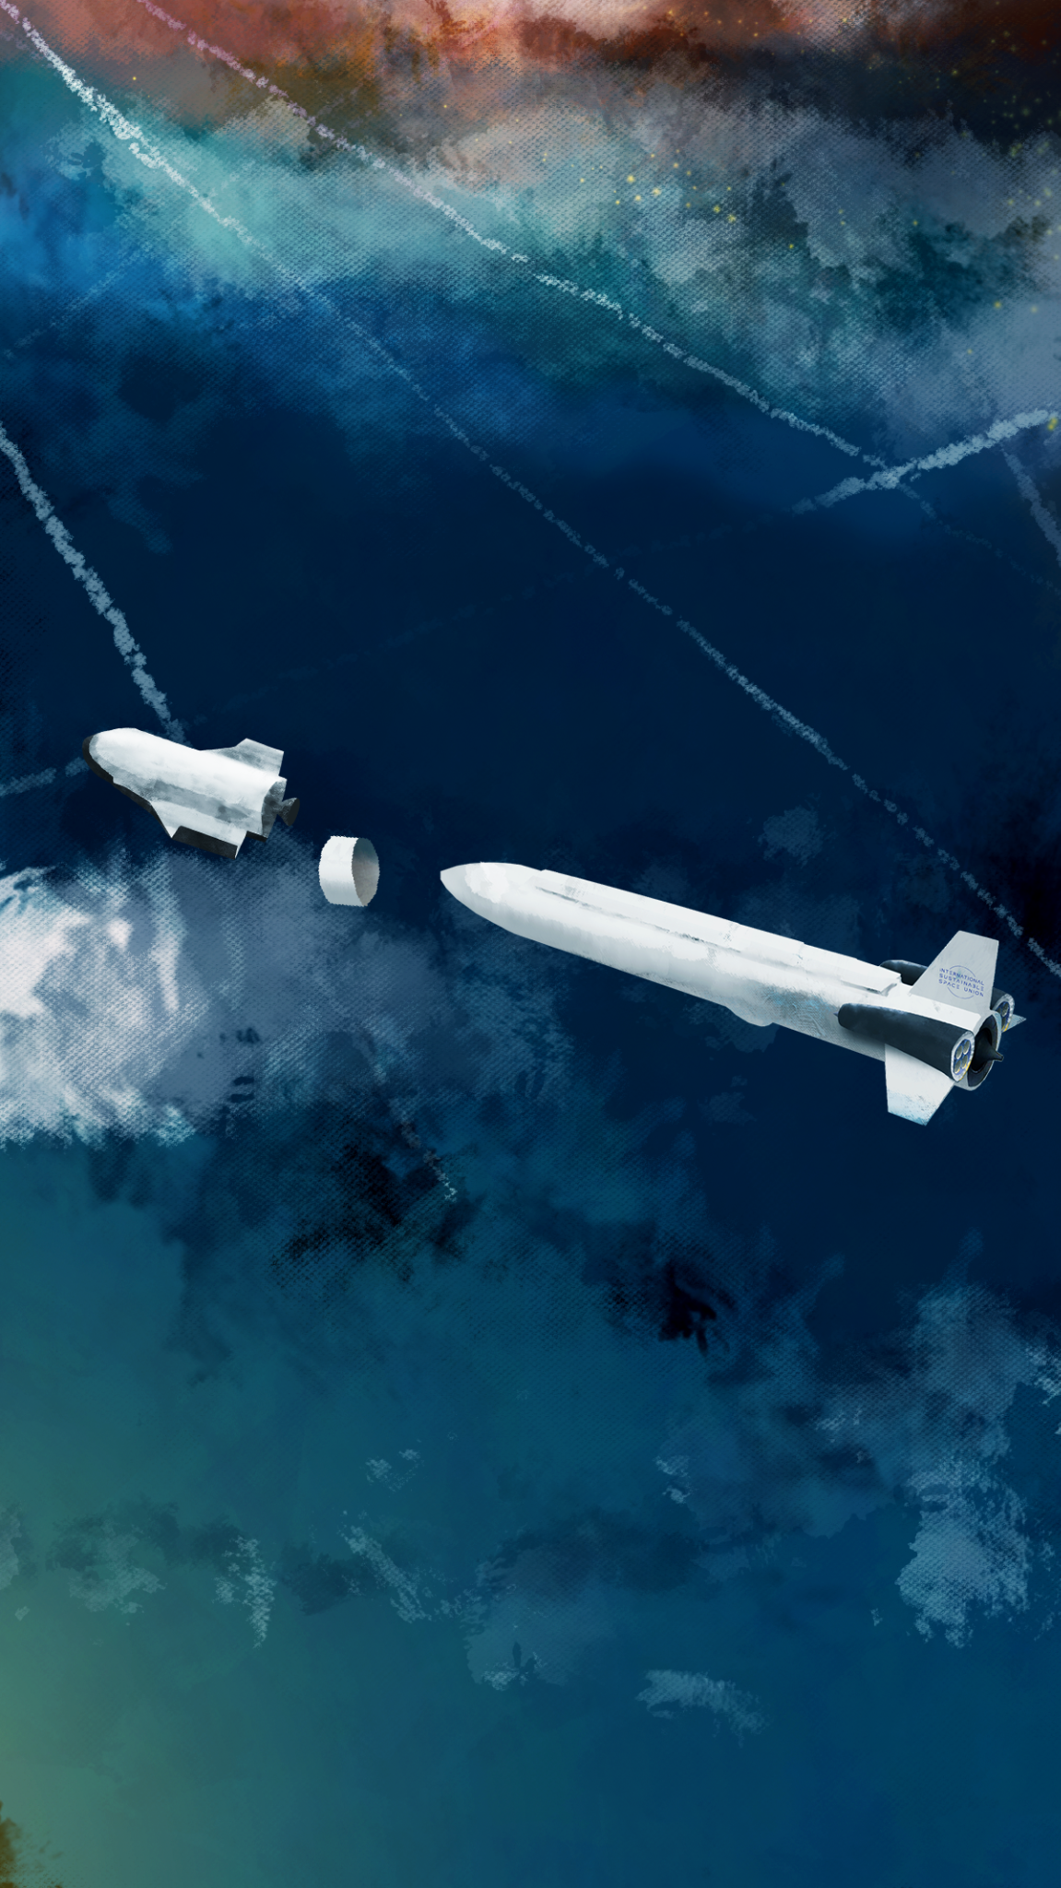
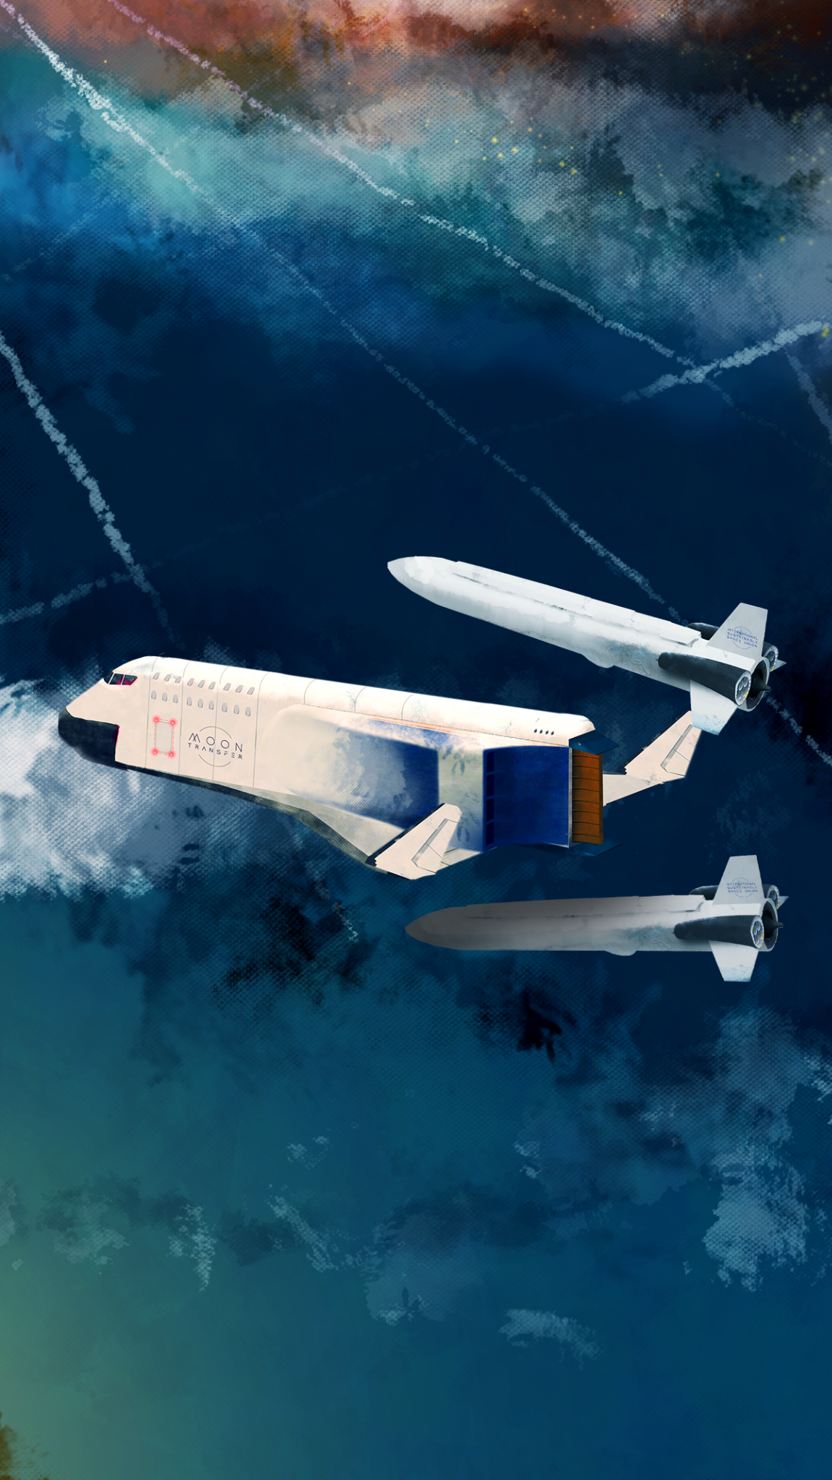

Slide 40
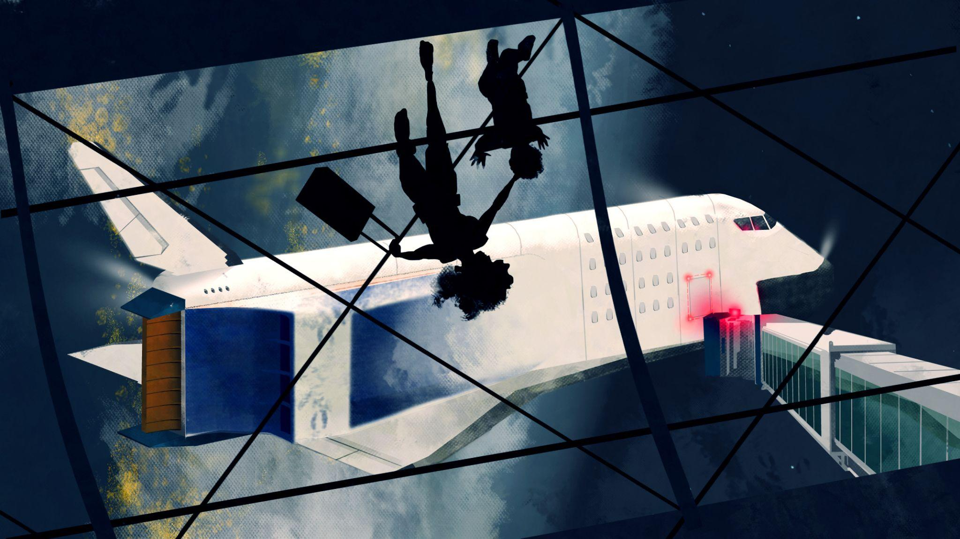

Slide 41
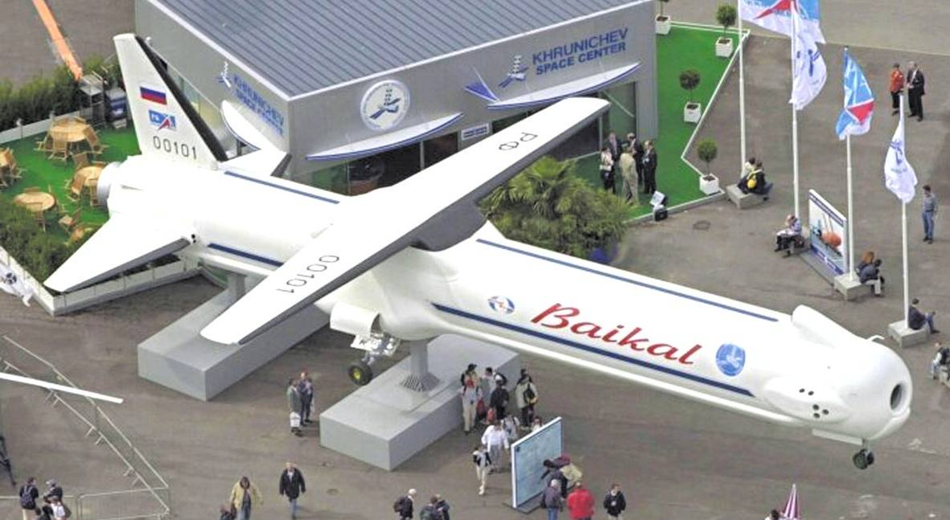

Slide 42
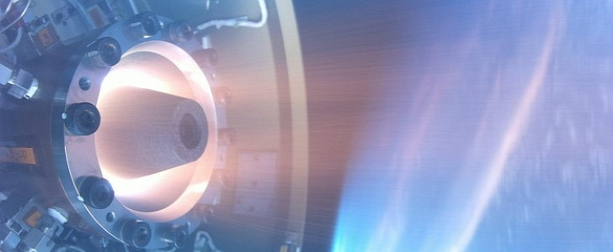
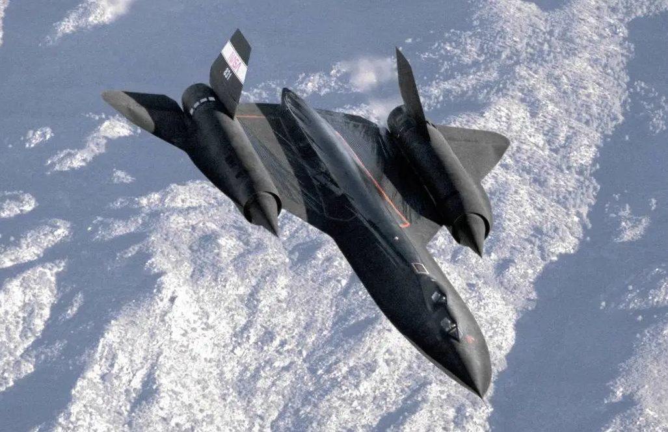

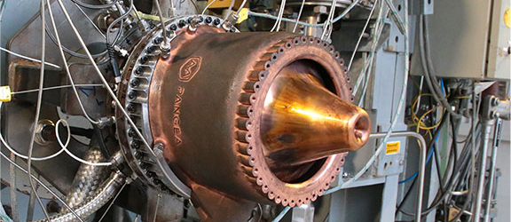


Slide 43
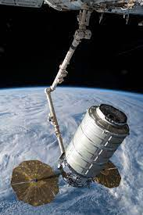

Slide 44
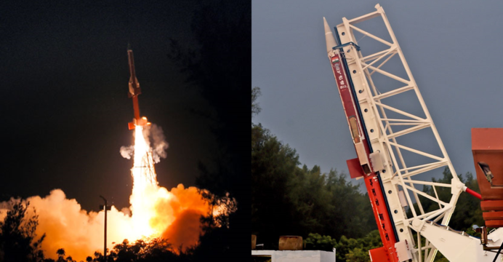
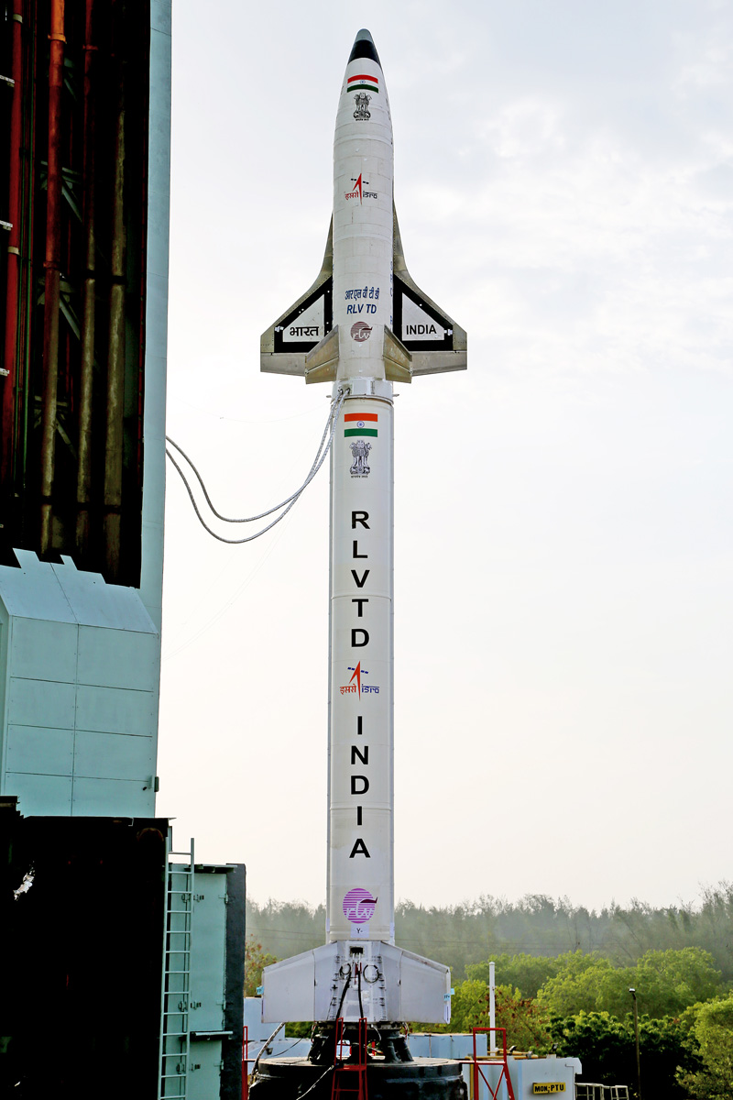

Slide 45
ISSU
LUNA TECH BASE
OFF-EARTH INDUSTRY
SUSTAINABLE LIVING IN SPACE
SPACE CULTURE
SPACE TOURISM

Slide 48
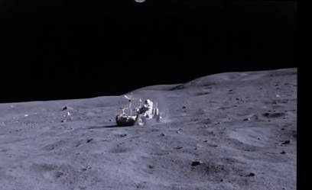

Slide 49
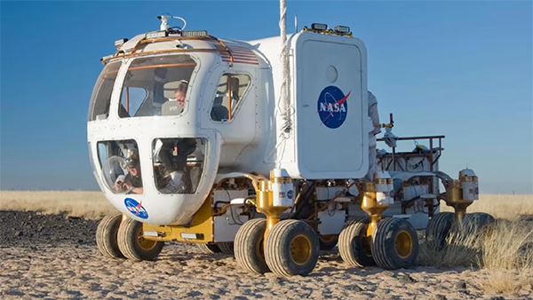

Slide 50


Slide 51


Slide 52


Slide 53


Slide 54



Kao što je ISS postao međunarodni projekt koji je ujedinio čoviječanstvo, čišćenje našeg svemirskog susjedstva može postati međunarodni poblem koji će ujediniti čoviječanstvo.
Why is securing a sustainable international Space program important?

Slide 55

Kao što je ISS postao međunarodni projekt koji je ujedinio čoviječanstvo, čišćenje našeg svemirskog susjedstva može postati međunarodni poblem koji će ujediniti čoviječanstvo.
maybe we should have developed a space program after all…

Slide 56
artstation.com/matijanagy
jacquesrougeriedatabase.com

